Slide 1
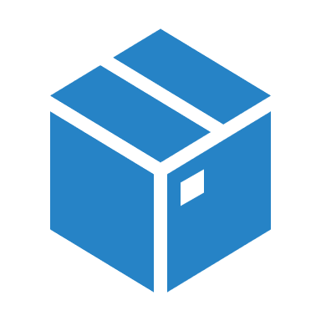
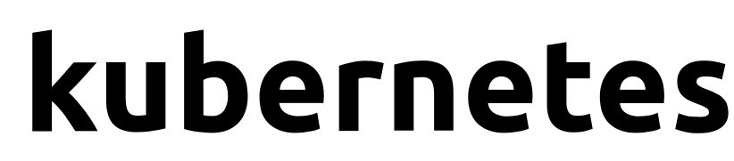
Notes:
Hello and welcome to this course on Kubernetes for the Absolute Beginners. My name is Gagandeep and I will be your instructor for this course.

Slide 2
Introduction
Name
Total Experience
Background – Development / Infrastructure / Database / Network
Experience on Docker/Kubernetes/Git/Jenkins
Your Expectations from this training

Slide 3
What is Container?

Slide 4
Introducing Containers
Container based virtualization uses the kernel on the host’s operating system to run multiple guest instances
Each guest instance is called a “Container”
Each container has its own
Root Filesystem
Processes
Memory
Devices
Network Ports
From outside its looks like a VM but its not a VM

Slide 5
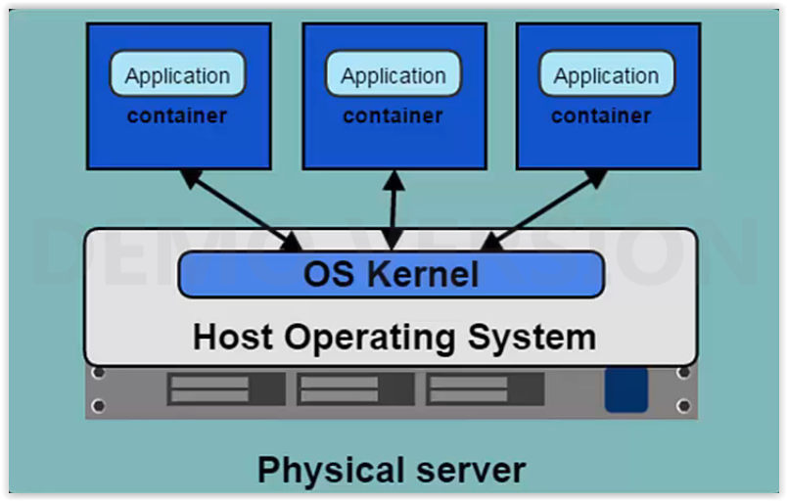
Overview of Containers
TechLanders Solutions

Slide 6
Overview of Containers
A question comes in our mind why do we need different containers of our applications.
A question to audience, I want to install:
Three application
Pre-requisites all three require different Java Versions
What will be the possible solution for this design

Slide 7
Containers VS VM’s
Container are more light weight
No need to install dedicated guest OS, no virtualization like VM is required
Stop/Start time is very fast
Less CPU, RAM, Storage Space required
More containers per machine than VM’s
Great Portability

Slide 8
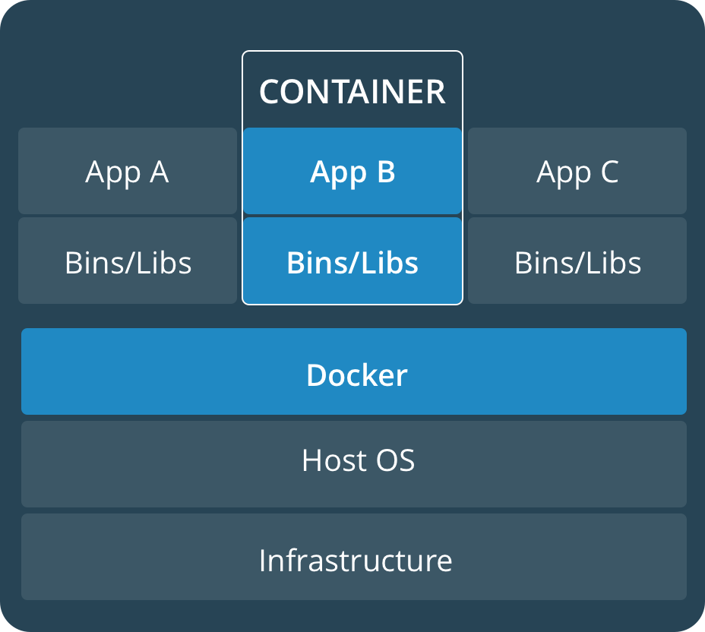
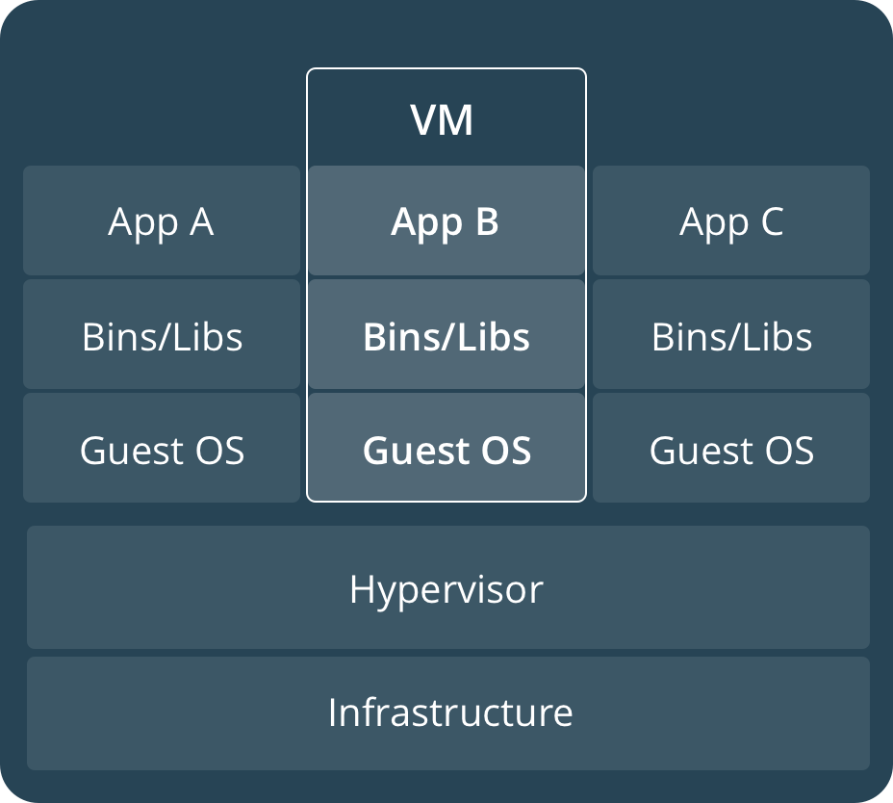
Containers VS VM’s
Containers are an app level construct
VMs are an infrastructure level construct to turn one machine into many servers

Slide 9
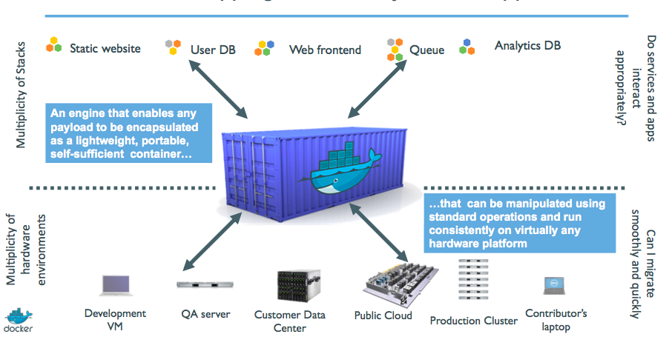
Shipping Container for Applications
TechLanders Solutions

Slide 10
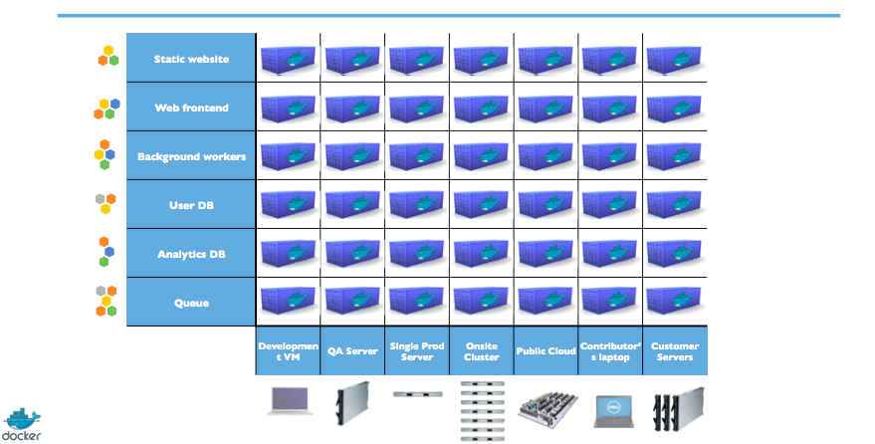
Eliminate the Matrix
TechLanders Solutions

Slide 11
Results
Speed
No OS to boot = applications online in seconds
Portability
Less dependencies between process layers = ability to move between infrastructure
Efficiency
Less OS overhead
Improved VM density

Slide 12
Session: 2
Docker Components

Slide 13

Docker Engine
TechLanders Solutions

Slide 14
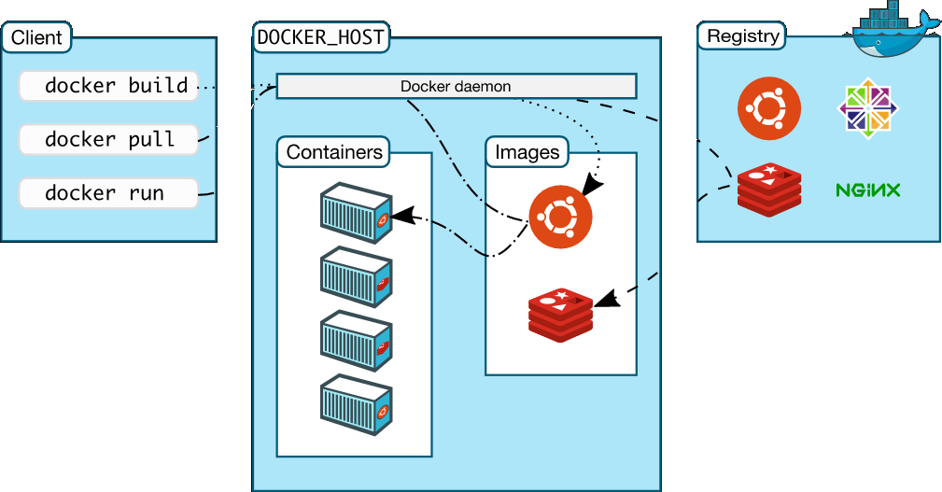
Docker Architecture
TechLanders Solutions

Slide 15
Docker Images
A Docker image is a read-only template with instructions for creating a Docker container.
For example, an image might contain an Ubuntu operating system with Apache web server and your web application installed. You can build or update images from scratch or download and use images created by others.
A docker image is described in text file called a Dockerfile, which has a simple, well-defined syntax.
Docker images are the build component of Docker.

Slide 16
Docker Containers
A Docker container is a running instance of a Docker image.
You can run, start, stop, move, or delete a container using Docker API or CLI commands.
When you run a container, you can provide configuration metadata such as networking information or environment variables.
Each container is an isolated and secure application platform, but can be given access to resources running in a different host or container, as well as persistent storage or databases.
Docker containers are the run component of Docker.

Slide 17
Docker Registries
A docker registry is a library of images.
A registry can be public or private, and can be on the same server as the Docker daemon or Docker client, or on a totally separate server.
Docker registries are the distribution component of Docker.
“Docker Hub” is known as global registry.

Slide 18
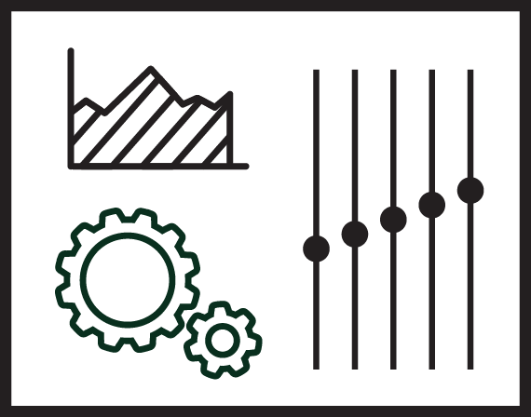


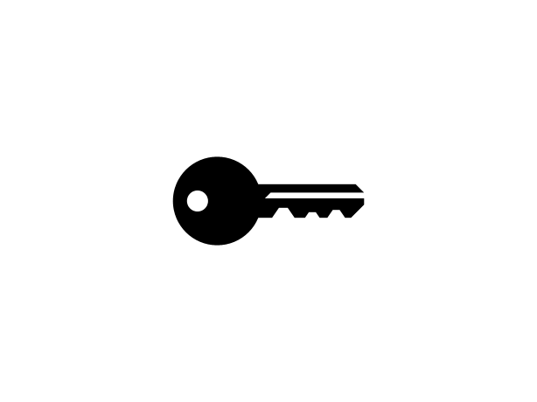
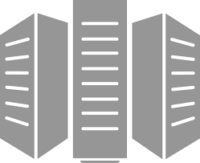
Container as a Service
Developers
IT Operations
BUILD
Development Environments
SHIP
Secure Content & Collaboration
RUN
Deploy, Manage, Scale
Control plane
Registry
Multi-container apps
Engines running on servers in cloud or datacenter
Clients pull and push images
Images stored in repos

Slide 19
Session: 3
Classroom Environment

Slide 20
Docker Engine Install Demo
Docker Engine/Client would be installed on Training Environment as demo LAB.
https://docs.docker.com/engine/installation/linux/centos/

Slide 21
Notes:
Hello and welcome to this course on Kubernetes for the Absolute Beginners. My name is Gagandeep and I will be your instructor for this course.

Slide 22
Containers
VM1
VM2
Container1
Container2
Container3
App3
App1
App2
App2
Lib/ Binaries
Guest OS
Guest OS
App1
Lib/ Binaries
Mini
OS
Application (App)
Operating System (OS)
Hypervisor
Linux Operating System
Physical Hardware
Physical Hardware
Physical Hardware
Traditional Approach
Virtualization
Containerization

Slide 23

Container Orchestration
Gagandeep
Notes:
In this lecture we will talk about Container Orchestration.

Slide 24
Containers Limitation?
High Availability?
Overlay Network?
Application Centric or Infra Centric?
Versioning of Application – Rollout, Rollback?
Scaling?
Autoscaling?
Monitoring?
Dependency between containers?
Notes:
So we learned about containers and we now have our application packaged into a docker container. But what next? How do you run it in production? What if your application relies on other containers such as databases or messaging services or other backend services? What if the number of users increase and you need to scale your application? How do you scale down when the load decreases.
<click> To enable these functionalities you need an underlying platform with a set of resources and capabilities. The platform needs to orchestrate the connectivity between the containers and automatically scale up or down based on the load. This whole process of automatically deploying and managing containers is known as Container Orchestration.

Slide 25
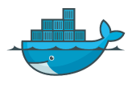
Container orchestration
Orchestration
Docker Host
Docker Host
Docker Host
Docker Host
Web
Container
Web
Container
Web
Container
Web
Container
Web
Container
MySQL
Container
Notes:
So we learned about containers and we now have our application packaged into a docker container. But what next? How do you run it in production? What if your application relies on other containers such as databases or messaging services or other backend services? What if the number of users increase and you need to scale your application? How do you scale down when the load decreases.
<click> To enable these functionalities you need an underlying platform with a set of resources and capabilities. The platform needs to orchestrate the connectivity between the containers and automatically scale up or down based on the load. This whole process of automatically deploying and managing containers is known as Container Orchestration.

Slide 26


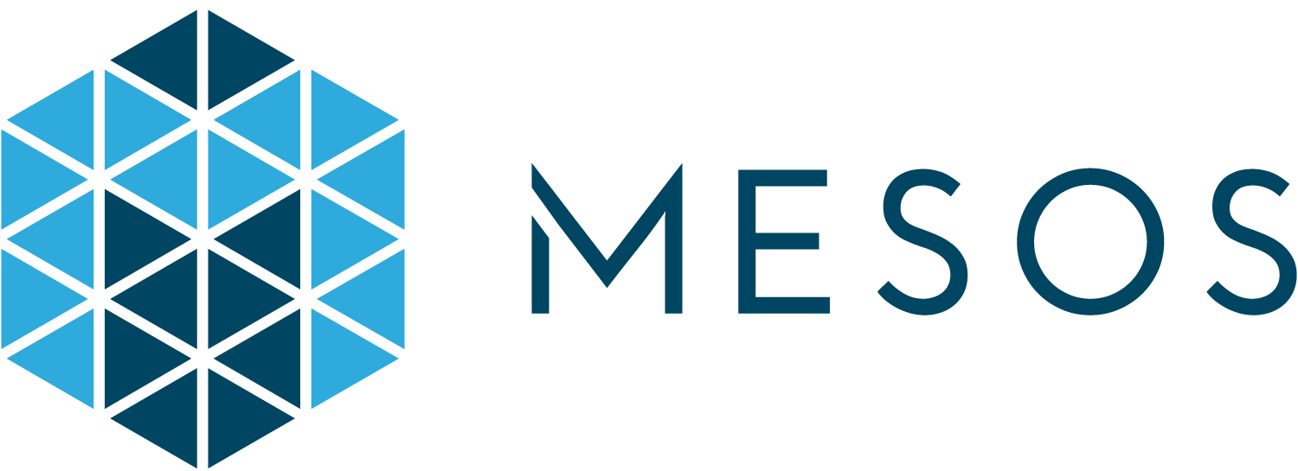
Orchestration Technologies
Docker Swarm
Notes:
Kubernetes is thus a container orchestration technology. There are multiple such technologies available today – Docker has its own tool called Docker Swarm. Kubernetes from Google and Mesos from Apache. While Docker Swarm is really easy to setup and get started, it lacks some of the advanced autoscaling features required for complex applications. Mesos on the other hand is quite difficult to setup and get started, but supports many advanced features. Kubernetes - arguably the most popular of it all – is a bit difficult to setup and get started but provides a lot of options to customize deployments and supports deployment of complex architectures. Kubernetes is now supported on all public cloud service providers like GCP, Azure and AWS and the kubernetes project is one of the top ranked projects in Github.

Slide 27
What is Kubernetes?
The Kubernetes project was started by Google in 2014.
Kubernetes builds upon a decade and a half of experience that Google has with running production workloads at scale.
Kubernetes can run on a range of platforms, from your laptop, to VMs on a cloud provider, to rack of bare metal servers.
Kubernetes is an open-source platform for automating deployment, scaling, and operations of application containers across clusters of hosts, providing container-centric infrastructure.
portable: with all public, private, hybrid, community cloud
self-healing: auto-placement, auto-restart, auto-replication, auto-scaling

Slide 28
Why Kubernetes
Kubernetes can schedule and run application containers on clusters of physical or virtual machines.
host-centric infrastructure to a container-centric infrastructure.
Orchestrator
Load balancing
Auto Scaling
Application Health checks
Rolling updates

Slide 29
Kubernetes Advantage
Orchestration
Kubernetes
Kubernetes
Kubernetes
Kubernetes
Kubernetes
Kubernetes
Web
Web
Web
Web
Web
Web
Web
Web
Web
Backend
Backend
Backend
Backend
Backend
Notes:
There are various advantages of container orchestration. Your application is now highly available as hardware failures do not bring your application down because you have multiple instances of your application running on different nodes. <click> The user traffic is load balanced across the various containers. <click> When demand increases, deploy more instances of the application seamlessly and within a matter of second and we have the ability to do that at a service level. <click> When we run out of hardware resources, scale the number of nodes up/down without having to take down the application. And do all of these easily with a set of declarative object configuration files.

Slide 30
And that is kubernetes..
Notes:
And THAT IS Kubernetes. It is a container Orchestration technology used to orchestrate the deployment and management of 100s and 1000s of containers in a clustered environment. Don’t worry if you didn’t get all of what was just said, in the upcoming lectures we will take a deeper look at the architecture and various concepts surrounding kubernetes. That is all for this lecture, thank you for listening and I will see you in the next lecture.

Slide 31
Setup
Gagandeep
Notes:
Hello and welcome to this lecture on setting up Kubernetes. My name is Gagandeep Singh and we are learning Kubernetes for Beginners. In this lecture we will look at the various options available in building a Kubernetes cluster from scratch.

Slide 32
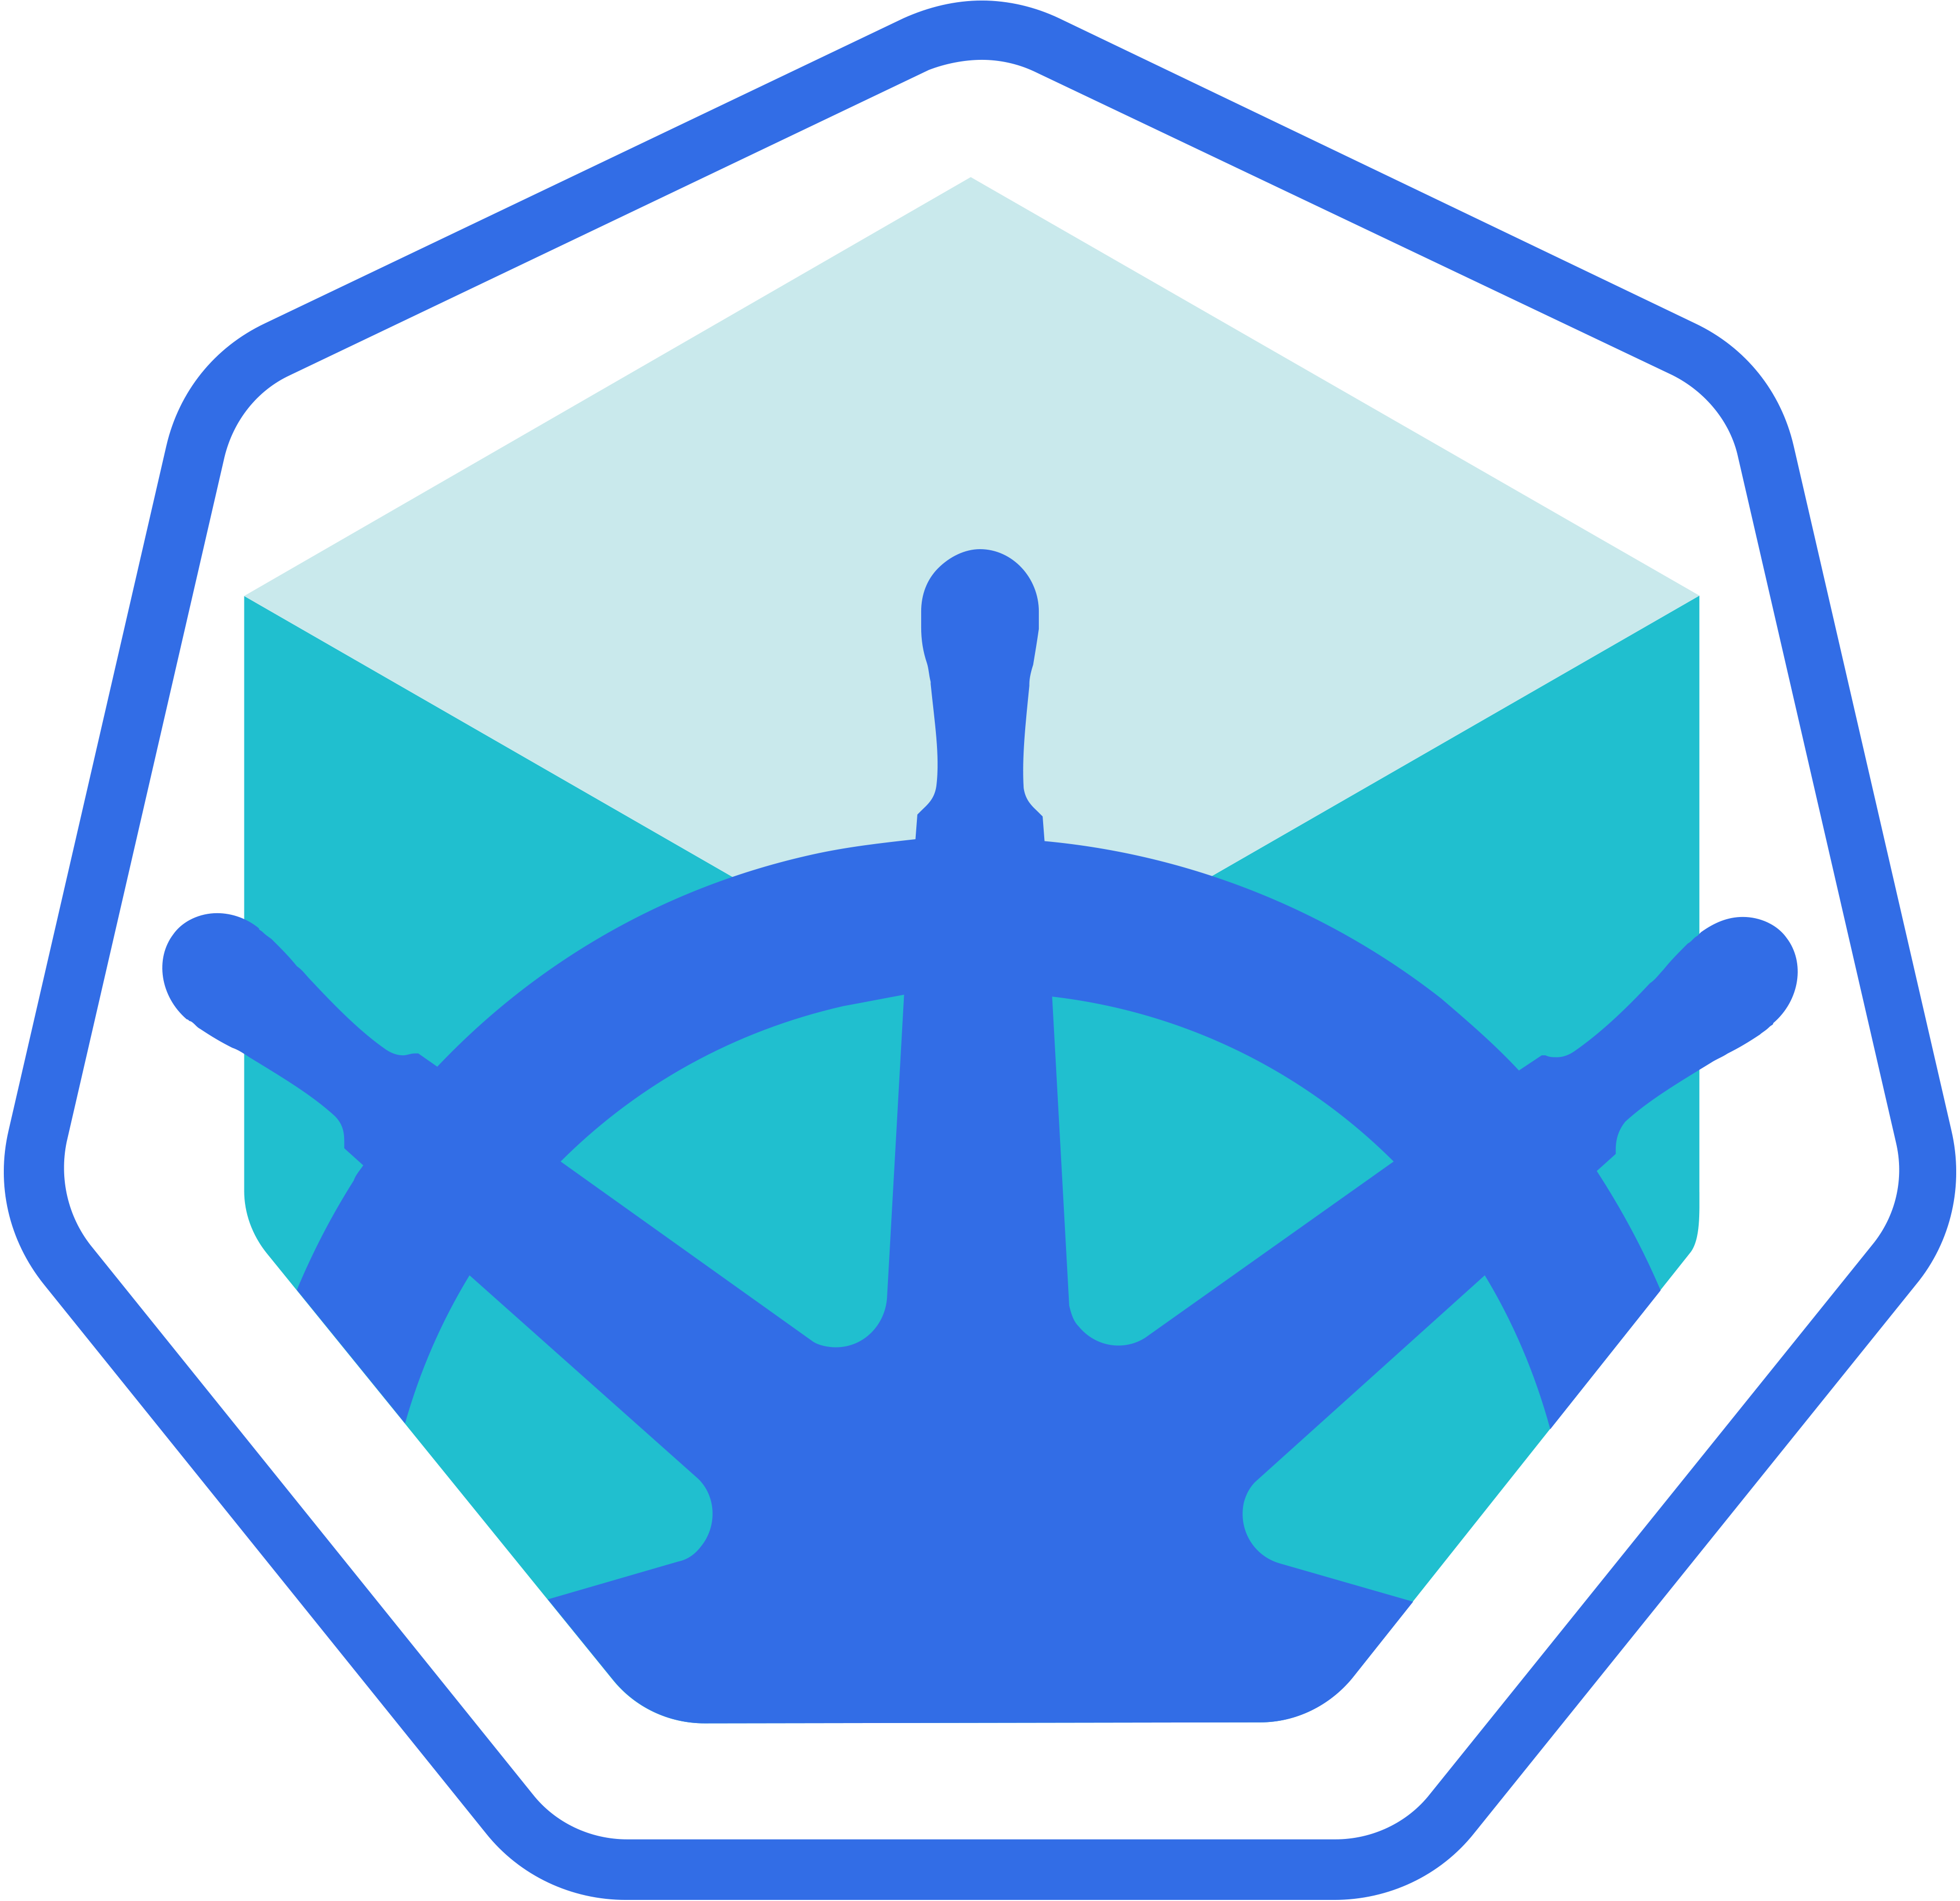
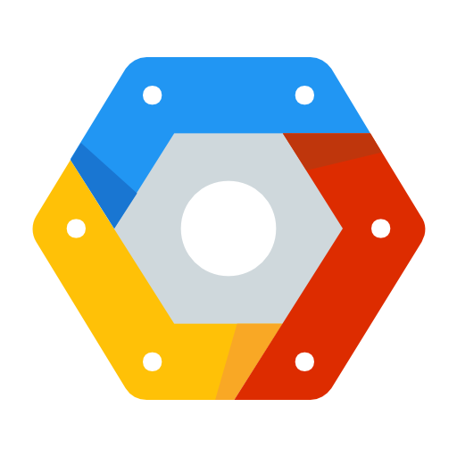
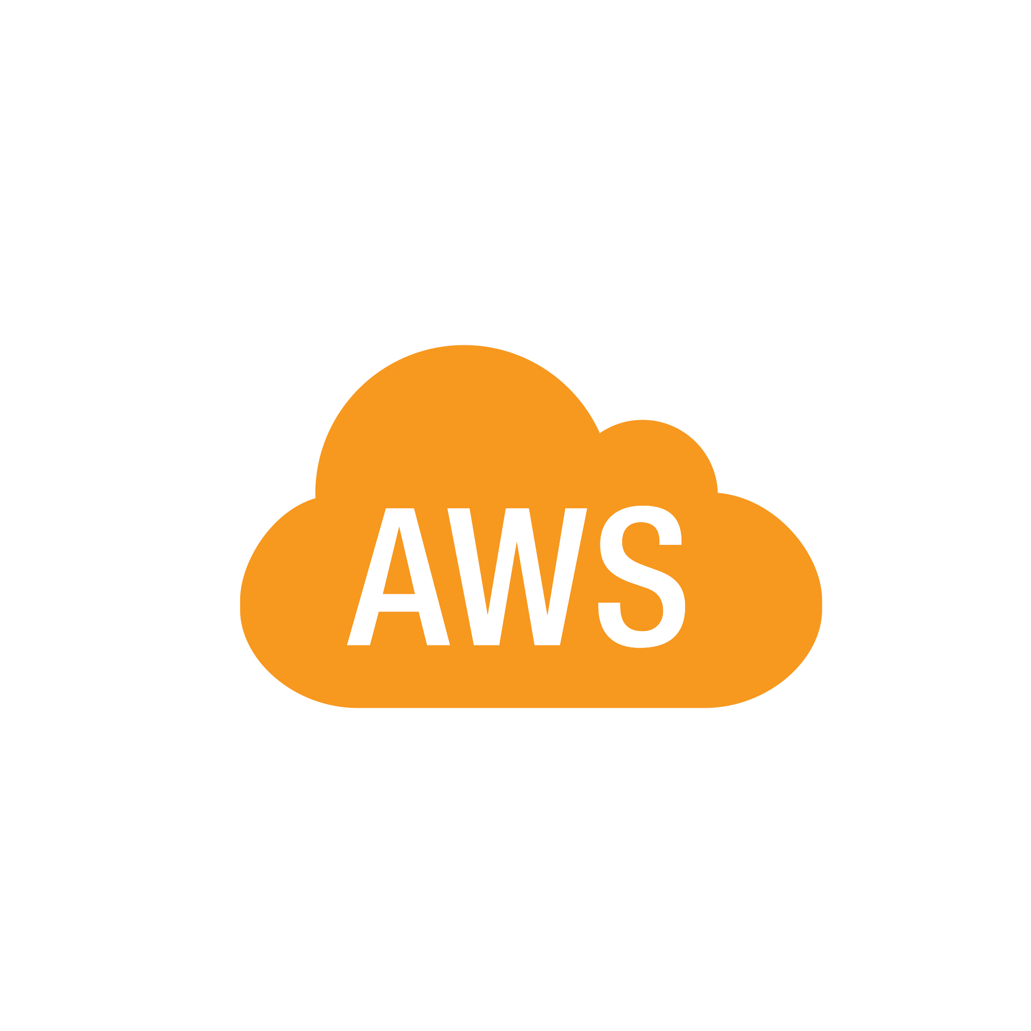
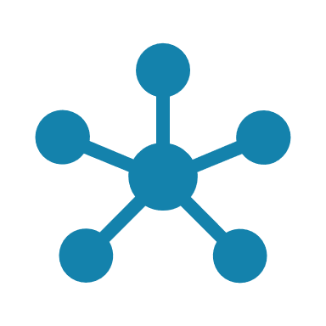
Setup Kubernetes
Minikube
Google Cloud Platform
play-with-k8s.com
Kubeadm
Amazon Web Services
Notes:
There are lots of ways to setup Kuberentes. We can setup it up ourselves locally on our laptops or virtual machines using solutions like Minikube and Kubeadmin. Minikube is a tool used to setup a single instance of Kubernetes in an All-in-one setup and kubeadmin is a tool used to configure kubernetes in a multi-node setup. We will look more into that in a bit.
<click>
There are also hosted solutions available for setting up kubernetes in a cloud environment such as GCP and AWS. We will also have some demos around those.
<click>
And finally if you don’t have the resources or if you don’t want to go through the hassle of setting it all up yourself, and you simply want to get your hands on a kubernetes cluster instantly to play with, checkout play-with-k8s.com . I also have a demo on this.
So feel free to chose the one that is right for you. You need not go through all the demos, pick the ones that best suite your needs based on your time and resources.

Slide 33





Minikube
Master
Minikube
Worker Node
</> kube-apiserver
</> kubelet
etcd
node-controller
replica-controller
Container Runtime
Notes:
We will start with Minikube which is the easiest way to get started with Kubernetes on a local system. If Minikube is not of interest to you, now would be a good time to skip this lecture. Before we head into the demo it’s good to understand how it works. Earlier we talked about the different components of Kubernetes that make up a Master and worker nodes such as the api server, etcd key value store, controllers and scheduler on the master and kubelets and container runtime on the worker nodes. It would take a lot of time and effort to setup and install all of these various components on different systems individually by ourlselves.
<click>
Minikube bundles all of these different components into a single image providing us a pre-configured single node kubernetes cluster so we can get started in a matter of minutes.
<click> The whole bundle is packaged into an ISO image and is available online for download.

Slide 34

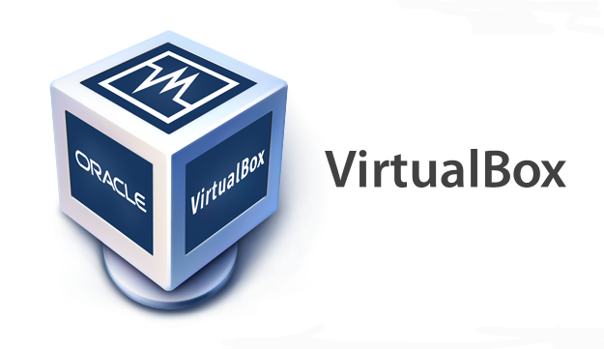
Minikube
Minikube.exe
kubectl
Single Node Kubernetes Cluster
Notes:
Now you don’t HAVE to download it yourself. Minikube provides an executable command line utility that will AUTOMATICALLY download the ISO and deploy it in a virtualization platform such as Oracle Virtualbox or Vmware fusion. So you must have a Hypervisor installed on your system. For windows you could use Virtualbox or Hyper-V and for Linux use Virtualbox or KVM.
<click>
And finally to interact with the kubernetes cluster, you must have the kubectl kubernetes command line tool also installed on your machine. <PAUSE> So you need 3 things to get this working, you must have a hypervisor installed, kubectl installed and minikube executable installed on your system.
So let’s get into the demo

Slide 35
Demo
minikube
Notes:
That’s it for this lecture, lets head over to the demo and see this in action.

Slide 36
Setup - kubeadm
Gagandeep
Notes:
Hello and welcome to this lecture on setting up Kubernetes with kubeadm. In this lecture we will look at the kubeadm tool which can be used to bootstrap a kubernetes cluster.

Slide 37
Kubernetes Cluster
A Kubernetes cluster consists of two types of resources:
Master: Which coordinates with the cluster
The Master is responsible for managing the cluster. The master coordinates all activities in your cluster, such as scheduling applications, maintaining applications' desired state, scaling applications, and rolling out new updates.
Nodes: Are the workers that run application
A node is a VM or a physical computer that serves as a worker machine in a Kubernetes cluster.
Masters manage the cluster and the nodes are used to host the running applications.
The nodes communicate with the master using the Kubernetes API, which the master exposes.

Slide 38
kubeadm
Master
Worker Node 1
Worker Node 2
Network Service
DNS Service
Proxy Service
</> kube-apiserver
etcd
node-controller
Network Service
Network Service
replica-controller
Proxy Service
Proxy Service
</> kubelet
</> kubelet
</> kubelet
Container Runtime
Container Runtime
Container Runtime
Notes:
With the minikube utility you could only setup a single node kubernetes cluster. The kubeadmin tool helps us setup a multi node cluster with master and workers on separate machines. Installing all of these various components individually on different nodes and modifying the configuration files to make it work is a tedious task. Kubeadmin tool helps us in doing all of that very easily.

Slide 39
Steps
Master
Worker Node 1
Worker Node 2
6
Join Node
Join Node
5
POD Network
4
Initialize
3
kubeadm
kubeadm
kubeadm
2
docker
docker
docker
1
Notes:
Let’s go through the steps – <click> First, you must have multiple systems or virtual machines created for configuring a cluster. We will see how to setup up your laptop to do just that if you are not familiar with it. Once the systems are created, designate one as master and others as worker nodes.
<click> The next step is to install a container runtime on the hosts. We will be using Docker, so we must install Docker on all the nodes.
<click> The next step is to install kubeadmin tool on all the nodes. The kubeadmin tool helps us bootstrap the kubernetes solution by installing and configuring all the required components in the right nodes.
<click> The third step is to initialize the Master server. During this process all the required components are installed and configured on the master server. That way we can start the cluster level configurations from the master server.
Once the master is initialized and before joining the worker nodes to the master, we must ensure that the network pre-requisites are met. A normal network connectivity between the systems is not SUFFICIENT for this. <click> Kubernetes requires a special network between the master and worker nodes which is called as a POD network. We will learn more about this network in the networking section later in this course. For now we will simply follow the instructions available to get this installed and setup in our environment.
The last step is to join the worker nodes to the master node. We are then all set to launch our application in the kubernetes environment.

Slide 40
Demo
kubeadm
Note: Pod Network Providers haven’t yet updated codes for V1.11 version of K8’s
Use: --feature-gates=CoreDNS=false along with POD network to use kube-dns services
Notes:
We will now see a demo of setting up kubernetes using the kubeadmin tool in our local environment.

Slide 41
Setup - kubeadm
Gagandeep
Notes:
This is the first part of setting up

Slide 42
POD
Gagandeep
Notes:
Hello and welcome to this lecture on Kubernetes PODs. My name is Gagandeep Singh and we are learning Kubernetes for Beginners. In this lecture we will discuss about Kubernetes PODs.

Slide 43
Assumptions
Docker Image
Kubernetes Cluster
Notes:
Before we head into understanding PODs, we would like to assume that the following have been setup already. At this point, we assume that the application is already developed and built into Docker Images and it is availalble on a Docker repository like Docker hub, so kubernetes can pull it down. We also assume that the Kubernetes cluster has already been setup and is working. This could be a single-node setup or a multi-node setup, doesn’t matter. All the services need to be in a running state.

Slide 44

POD
Node
Node
Node
POD
POD
POD
Notes:
As we discussed before, <click> with kubernetes our ultimate aim is to deploy our application in the form of containers on a set of machines that are configured as worker nodes in a cluster. <click> However, kubernetes does not deploy containers directly on the worker nodes. The containers are encapsulated into a Kubernetes object known as PODs. A POD is a single instance of an application. A POD is the smallest object, that you can create in kubernetes.

Slide 45

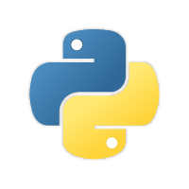
POD
Kubernetes Cluster
Node
Node
POD
POD
POD
Notes:
Here we see the simplest of simplest cases were you have a single node kubernetes cluster with a single instance of your application running in a single docker container encapsulated in a POD. <click> What if the number of users accessing your application increase and you need to scale your application? You need to add additional instances of your web application to share the load. Now, were would you spin up additional instances? <click> Do we bring up a new container instance within the same POD? <click> No! We create a new POD altogether with a new instance of the same application. As you can see we now have two instances of our web application running on two separate PODs on the same kubernetes system or node.
<click> What if the user base FURTHER increases and your current node has no sufficient capacity? <click> Well THEN you can always deploy additional PODs on a new node in the cluster. You will have a new node added to the cluster to expand the cluster’s physical capacity. <pause> SO, what I am trying to illustrate in this slide is that, PODs usually have a one-to-one relationship with containers running your application. To scale UP you create new PODs and to scale down you delete PODs. You do not add additional containers to an existing POD to scale your application. <pause> Also, if you are wondering how we implement all of this and how we achieve load balancing between containers etc, we will get into all of that in a later lecture. For now we are ONLY trying to understand the basic concepts.

Slide 46

Multi-Container PODs
Node
POD
Network
Helper Containers
Notes:
Now we just said that PODs usually have a one-to-one relationship with the containers, but, are we restricted to having a single container in a single POD? No! A single POD CAN have multiple containers, except for the fact that they are usually not multiple containers of the same kind. As we discussed in the previous slide, if our intention was to scale our application, then we would need to create additional PODs. <click> But sometimes you might have a scenario were you have a helper container, that might be doing some kind of supporting task for our web application such as processing a user entered data, processing a file uploaded by the user etc. and you want these helper containers to live along side your application container. In that case, you CAN have both of these containers part of the same POD, so that when a new application container is created, the helper is also created and when it dies the helper also dies since they are part of the same POD. <click> The two containers can also communicate with each other directly by referring to each other as ‘localhost’ since they share the same network namespace. Plus they can easily share the same storage space as well.

Slide 47
PODs Again!
docker run python-app
Node
docker run python-app
POD
POD
POD
POD
docker run python-app
docker run python-app
docker run helper –link app1
docker run helper –link app2
docker run helper –link app3
docker run helper –link app4
Volume
Vol1
Vol2
App | Helper
Python1 | App1
Python2 | App2
Note: I am avoiding networking and load balancing details to keep explanation simple.
Notes:
If you still have doubts in this topic (I would understand if you did because I did the first time I learned these concepts), we could take another shot at understanding PODs from a different angle. Let’s, for a moment, keep kubernetes out of our discussion and talk about simple docker containers. Let’s assume we were developing a process or a script to deploy our application on a docker host. <click> Then we would first simply deploy our application using a simple docker run python-app command and the application runs fine and our users are able to access it. <click> When the load increases we deploy more instances of our application by running the docker run commands many more times. This works fine and we are all happy. <click> Now, sometime in the future our application is further developed, undergoes architectural changes and grows and gets complex. We now have new helper containers that helps our web applications by processing or fetching data from elsewhere. These helper containers maintain a one-to-one relationship with our application container and thus, needs to communicate with the application containers directly and access data from those containers. <click> For this we need to maintain a map of what app and helper containers are connected to each other, we would need to establish network connectivity between these containers ourselves using links and custom networks, we would need to create shareable volumes and share it among the containers and <click> maintain a map of that as well. And most importantly we would need to monitor the state of the application container and <click> when it dies, manually kill the helper container as well as its no longer required. When a new container is deployed we would need to deploy the new helper container as well.
<click> With PODs, kubernetes does all of this for us automatically. We just need to define what containers a POD consists of and the containers in a POD by default will have access to the same storage, the same network namespace, and same fate as in they will be created together and destroyed together.
Even if our application didn’t happen to be so complex and we could live with a single container, kubernetes still requires you to create PODs. But this is good in the long run as your application is now equipped for architectural changes and scale in the future.
However, multi-pod containers are a rare use-case and we are going to stick to single container per POD in this course.

Slide 48
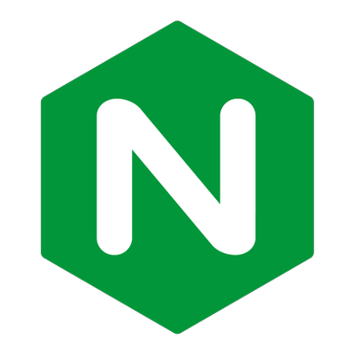
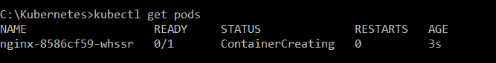
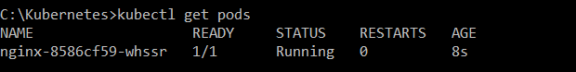
kubectl
–-image nginx
kubectl run nginx
kubectl get pods
Node
POD
Notes:
Let us now look at how to deploy PODs. <click> Earlier we learned about the kubectl run command. What this command really does is it deploys a docker container by creating a POD. So it first creates a POD automatically and deploys an instance of the nginx docker image. <click> But were does it get the application image from? <click> For that you need to specify the image name using the –-image parameter. The application image, in this case the nginx image, is downloaded from the docker hub repository. Docker hub as we discussed is a public repository were latest docker images of various applications are stored. You could configure kubernetes to pull the image from the public docker hub or a private repository within the organization.
Now that we have a POD created, how do we see the list of PODs available? <click> The kubectl get PODs command helps us see the list of pods in our cluster. In this case we see the pod is in a ContainerCreating state and soon changes to a Running state when it is actually running.
Also remember that we haven’t really talked about the concepts on how a user can access the nginx web server. And so in the current state we haven’t made the web server accessible to external users. You can access it internally from the Node though. <click> For now we will just see how to deploy a POD and in a later lecture once we learn about networking and services we will get to know how to make this service accessible to end users.

Slide 49
Demo
POD
Notes:
That’s it for this lecture. We will now head over to a Demo and I will see you in the next lecture.

Slide 50
YAML Introduction
Gagandeep
Notes:
We just saw how to create a POD from command line. But you can also create a POD using a POD definition file. In fact most of Kubernetes configuration is done in definition files based in YAML format. When the application configuration gets complex, you will see that it is EASIER to use YAML files to define the configuration. As such at this point we will make sure that we are all comfortable with YAML files and its structure. This is important because going forward we will be working with YAML files extensively. The next lecture is going to be a very basic introduction to YAML file. And that will be followed by some coding exercises that will help you get familiar with YAML files using simple examples. If you are already familiar with YAML, please skip this lecture and coding exercises and move forward to the next lecture.

Slide 51
POD
With YAML
Notes:
Hello and welcome to this lecture, my name is Gagandeep Singh and we are learning kubernetes for beginners. In this lecture we will talk about creating a POD using a YAML based configuration file.

Slide 52


YAML in Kubernetes
pod-definition.yml
String
Kind | Version
POD | v1
Service | v1
ReplicaSet | apps/v1
Deployment | apps/v1
apiVersion: kind: metadata:
spec:
v1
Pod
String
metadata:
name: myapp-pod labels: app: myapp
name: myapp-pod
Dictionary
labels: app: myapp
type: front-end
List/Array
containers: - name: nginx-container
image: nginx
1st Item in List
kubectl create –f pod-definition.yml
Notes:
In the previous lecture we learned about YAML files in general. Now we will learn how to develop YAML files specifically for Kubernetes. Kubernetes uses YAML files as input for the creation of objects such as PODs, Replicas, Deployments, Services etc. All of these follow similar structure. A kubernetes definition file always contains 4 top level fields. <click> The apiVersion, kind, metadata and spec. These are top level or root level properties. Think of them as siblings, children of the same parent. These are all REQUIRED fields, so you MUST have them in your configuration file.
Let us look at each one of them. The first one is the apiVersion. This is the version of the kubernetes API we’re using to create the object. Depending on what we are trying to create we must use the RIGHT apiVersion. For now since we are working on PODs, <click 2> we will set the apiVersion as v1. Few other possible values for this field are apps/v1beta1, extensions/v1beta1 etc. We will see what these are for later in this course.
Next is the kind. The kind refers to the type of object we are trying to create, which in this case happens to be a POD. So we will set it as Pod. Some other possible values here could be ReplicaSet or Deployment or Service, which is what you see in the kind field in the table on the right.
The next is metadata. <click> The metadata is data about the object like its name, labels etc. <click> As you can see unlike the first two were you specified a string value, this, is in the form of a dictionary. <click> So everything under metadata is intended to the right a little bit and so names and labels are children of metadata. <click> The number of spaces before the two properties name and labels doesn’t matter, <click> but they should be the same as they are siblings. In this case labels has more spaces on the left than name and so it is now a child of the name property instead of a sibling. <click> Also the two properties must have MORE spaces than its parent, which is metadata, so that its intended to the right a little bit. In this case all 3 have the same number of spaces before them and so they are all siblings, which is not correct. <click> Under metadata, the name is a string value – so you can name your POD myapp-pod - and the labels is a dictionary. So labels is a dictionary within the metadata dictionary. And it can have any key and value pairs as you wish. For now I have added a label app with the value myapp. Similarly you could add other labels as you see fit which will help you identify these objects at a later point in time. Say for example there are 100s of PODs running a front-end application, and 100’s of them running a backend application or a database, it will be DIFFICULT for you to group these PODs once they are deployed. <click> If you label them now as front-end, back-end or database, you will be able to filter the PODs based on this label at a later point in time.
It’s IMPORTANT to note that under metadata, you can only specify name or labels or anything else that kubernetes expects to be under metadata. You CANNOT add any other property as you wish under this. However, under labels you CAN have any kind of key or value pairs as you see fit. So its IMPORTANT to understand what each of these parameters expect.
So far we have only mentioned the type and name of the object we need to create which happens to be a POD with the name myapp-pod, but we haven’t really specified the container or image we need in the pod. The last section in the configuration file is the specification which is written as spec. Depending on the object we are going to create, this is were we provide additional information to kubernetes pertaining to that object. This is going to be different for different objects, so its important to understand or refer to the documentation section to get the right format for each. Since we are only creating a pod with a single container in it, it is easy. Spec is a dictionary so add a property under it called containers, <click> which is a list or an array. The reason this property is a list is because the PODs can have multiple containers within them as we learned in the lecture earlier. In this case though, we will only add a single item in the list, <click> since we plan to have only a single container in the POD. The item in the list is a dictionary, so add a name and image property. The value for image is nginx. <click>
<click>
Once the file is created, run the command kubectl create -f followed by the file name which is pod-definition.yml and kubernetes creates the pod.
So to summarize remember the 4 top level properties. apiVersion, kind, metadata and spec. Then start by adding values to those depending on the object you are creating.

Slide 53
Commands
> kubectl get pods
NAME READY STATUS RESTARTS AGE
myapp-pod 1/1 Running 0 20s
> kubectl describe pod myapp-pod
Name: myapp-pod
Namespace: default
Node: minikube/192.168.99.100
Start Time: Sat, 03 Mar 2018 14:26:14 +0800
Labels: app=myapp
name=myapp-pod
Annotations: <none>
Status: Running
IP: 10.244.0.24
Containers:
nginx:
Container ID: docker://830bb56c8c42a86b4bb70e9c1488fae1bc38663e4918b6c2f5a783e7688b8c9d
Image: nginx
Image ID: docker-pullable://nginx@sha256:4771d09578c7c6a65299e110b3ee1c0a2592f5ea2618d23e4ffe7a4cab1ce5de
Port: <none>
State: Running
Started: Sat, 03 Mar 2018 14:26:21 +0800
Ready: True
Restart Count: 0
Environment: <none>
Mounts:
/var/run/secrets/kubernetes.io/serviceaccount from default-token-x95w7 (ro)
Conditions:
Type Status
Initialized True
Ready True
PodScheduled True
Events:
Type Reason Age From Message
---- ------ ---- ---- -------
Normal Scheduled 34s default-scheduler Successfully assigned myapp-pod to minikube
Normal SuccessfulMountVolume 33s kubelet, minikube MountVolume.SetUp succeeded for volume "default-token-x95w7"
Normal Pulling 33s kubelet, minikube pulling image "nginx"
Normal Pulled 27s kubelet, minikube Successfully pulled image "nginx"
Normal Created 27s kubelet, minikube Created container
Normal Started 27s kubelet, minikube Started container
Notes:
Once we create the pod, how do you see it? Use the <click> kubectl get pods command to see a list of pods available. In this case its just one. To see detailed information about the pod run the <click> kubectl describe pod command. This will tell you information about the POD, when it was created, what labels are assigned to it, what docker containers are part of it and the events associated with that POD.

Slide 54
Demo
POD Using YAML
Notes:
That’s it for this lecture. We will now head over to a Demo and I will see you in the next lecture.

Slide 55
Tips & Tricks
Working YAML Files
Notes:
That’s it for this lecture. We will now head over to a Demo and I will see you in the next lecture.

Slide 56
Coding Exercises
Gagandeep
Notes:
We just saw how to create a POD from command line. But you can also create a POD using a POD definition file. In fact most of Kubernetes configuration is done in definition files based in YAML format. When the application configuration gets complex, you will see that it is EASIER to use YAML files to define the configuration. As such at this point we will make sure that we are all comfortable with YAML files and its structure. This is important because going forward we will be working with YAML files extensively. The next lecture is going to be a very basic introduction to YAML file. And that will be followed by some coding exercises that will help you get familiar with YAML files using simple examples. If you are already familiar with YAML, please skip this lecture and coding exercises and move forward to the next lecture.

Slide 57
Resources
Link to Versions and Groups - https://kubernetes.io/docs/reference/generated/kubernetes-api/v1.9/#replicaset-v1-apps
https://plugins.jetbrains.com/plugin/9354-kubernetes-and-openshift-resource-support
For Pods: https://kubernetes.io/docs/reference/generated/kubernetes-api/v1.11/#pod-v1-core

Slide 58
Replication Controller
Gagandeep
Notes:
Hello and welcome to this lecture on Kubernetes Controllers. My name is Gagandeep Singh and we are learning Kubernetes for Beginners. In this lecture we will discuss about Kubernetes Controllers. Controllers are the brain behind Kubernetes. They are processes that monitor kubernetes objects and respond accordingly. In this lecture we will discuss about one controller in particular. And that is the Replication Controller.

Slide 59

High Availability
Node
Replication Controller
Node
POD
POD
Replication Controller
POD
POD
Notes:
So what is a replica and why do we need a replication controller? <click> Let’s go back to our first scenario were we had a single POD running our application. <click> What if for some reason, our application crashes and the POD fails? Users will no longer be able to access our application. To prevent users from losing access to our application, we would like to have more than one instance or POD running at the same time. That way if one fails we still have our application running on the other one. <click> The replication controller helps us run multiple instances of a single POD in the kubernetes cluster thus providing <click> High Availability.
<click> So does that mean you can’t use a replication controller if you plan to have a single POD? No! Even if you have a single POD, <click> the replication controller can help by automatically bringing up a new POD when the existing one fails. Thus the replication controller ensures that the specified number of PODs are running at all times. Even if it’s just 1 or 100.

Slide 60
Load Balancing & Scaling
Node
Node
Replication Controller
Replication Controller
POD
POD
POD
POD
Notes:
Another reason we need replication controller is to create multiple PODs to share the load across them. For example, <click> in this simple scenario we have a single POD serving a set of users. <click> When the number of users increase we deploy additional POD to balance the load across the two pods. <click> If the demand further increases and If we were to run out of resources on the first node, we could deploy additional PODs across other nodes in the cluster. As you can see, the replication controller spans across multiple nodes in the cluster. It helps us balance the load across multiple pods on different nodes as well as scale our application when the demand increases.

Slide 61
Replication Controller
Replica Set
Notes:
It’s important to note that there are two similar terms. Replication Controller and Replica Set. Both have the same purpose but they are not the same. Replication Controller is the older technology that is being replaced by Replica Set. Replica set is the new recommended way to setup replication. However, whatever we discussed in the previous few slides remain applicable to both these technologies. There are minor differences in the way each works and we will look at that in a bit.
As such we will try to stick to Replica Sets in all of our demos and implementations going forward.
<Discuss more if possible>

Slide 62
rc-definition.yml
pod-definition.yml
apiVersion: kind: metadata:
spec:
v1
apiVersion: kind:
v1
ReplicationController
Pod
Replication Controller
name: myapp-rc labels: app: myapp
type: front-end
metadata:
name: myapp-pod labels: app: myapp
type: front-end
spec:
containers: - name: nginx-container
image: nginx
Replication Controller
template:
POD
POD
POD
POD
> kubectl create –f rc-definition.yml
replicationcontroller “myapp-rc” created
> kubectl get replicationcontroller
NAME DESIRED CURRENT READY AGE
myapp-rc 3 3 3 19s
replicas:
3
> kubectl get pods
NAME READY STATUS RESTARTS AGE
myapp-rc-4lvk9 1/1 Running 0 20s
myapp-rc-mc2mf 1/1 Running 0 20s
myapp-rc-px9pz 1/1 Running 0 20s
Notes:
Let us now look at how we create a replication controller. <click> As with the previous lecture, we start by creating a replication controller definition file. We will name it rc-definition.yml. As with any kubernetes definition file, we will have 4 sections. The apiVersion, kind, metadata and spec. The apiVersion is specific to what we are creating. In this case replication controller is supported in kubernetes apiVersion v1. <click> So we will write it as v1. <click> The kind as we know is ReplicationController. Under metadata, we will add a name and we will call it myapp-rc. And we will also add a few labels, app and type and assign values to them. So far, it has been very similar to how we created a POD in the previous section. The next is the most crucial part of the definition file and that is the specification written as spec. For any kubernetes definition file, the spec section defines what’s inside the object we are creating. In this case we know that the replication controller creates multiple instances of a POD. But what POD? <click> We create a template section under spec to provide a POD template to be used by the replication controller to create replicas. Now <pause> how do we DEFINE the POD template? It’s not that hard because, we have already done that in the previous exercise. <click> Remember, we created a pod-definition file in the previous exercise. We could re-use the contents of the same file to populate the template section. <click> Move all the contents of the pod-definition file into the template section of the replication controller, except for the first two lines – which are apiVersion and kind. <click> Remember whatever we move must be UNDER the template section. Meaning, they should be intended to the right and have more spaces before them than the template line itself. <click> Looking at our file, we now have two metadata sections – one is for the Replication Controller and another for the POD and <click> we have two spec sections – one for each. We have nested two definition files together. The replication controller being the parent and the pod-definition being the child.
<click> Now, there is something still missing. <click> We haven’t mentioned how many replicas we need in the replication controller. For that, <click> add another property to the spec called replicas and <click> input the number of replicas you need under it. Remember that the template and replicas are direct children of the spec section. So they are siblings and must be on the same vertical line : having equal number of spaces before them.
Once the file is ready, <click> run the kubectl create command and input the file using the –f parameter. The replication controller Is created. When the replication controller is created it first creates the PODs using the pod-definition template as many as required, which is 3 in this case. To view the list of created replication controllers <click> run the kubectl get replication controller command and you will see the replication controller listed. We can also see the desired number of replicas or pods, the current number of replicas and how many of them are ready. If you would like to see the pods that were created by the replication controller, run the <click> kubectl get pods command and you will see 3 pods running. Note that all of them are starting with the name of the replication controller which is myapp-rc indicating that they are all created automatically by the replication controller.

Slide 63
replicaset-definition.yml
pod-definition.yml
apiVersion: kind: metadata:
spec:
apps/v1
apiVersion: kind:
v1
ReplicaSet
Pod
name: myapp-replicaset labels: app: myapp
type: front-end
error: unable to recognize "replicaset-definition.yml": no matches for /, Kind=ReplicaSet
metadata:
name: myapp-pod labels: app: myapp
type: front-end
spec:
containers: - name: nginx-container
image: nginx
template:
POD
POD
> kubectl create –f replicaset-definition.yml
replicaset "myapp-replicaset" created
> kubectl get replicaset
NAME DESIRED CURRENT READY AGE
myapp-replicaset 3 3 3 19s
replicas:
3
> kubectl get pods
selector:
matchLabels:
type: front-end
NAME READY STATUS RESTARTS AGE
myapp-replicaset-9ddl9 1/1 Running 0 45s
myapp-replicaset-9jtpx 1/1 Running 0 45s
myapp-replicaset-hq84m 1/1 Running 0 45s
Notes:
What we just saw was ReplicationController. Let us now look at ReplicaSet. It is very similar to replication controller. <click> As usual, first we have apiVersion, kind, metadata and spec. The apiVersion though is a bit different. It is apps/v1 which is different from what we had before for replication controller. For replication controller it was simply v1. <click> If you get this wrong, you are likely to get an error that looks like this. It would say no match for kind ReplicaSet, because the specified kubernetes api version has no support for ReplicaSet.
<click>
<click> The kind would be ReplicaSet and we add <click> name and labels in metadata.
The specification section looks very similar to replication controller. <click> It has a template section were we provide pod-definition as before. <click> So I am going to copy contents over from pod-definition file. And we have number of replicas set to 3. However, there is one major difference between replication controller and replica set. <click> Replica set requires a selector definition. The selector section helps the replicaset identify what pods fall under it. But why would you have to specify what PODs fall under it, if you have provided the contents of the pod-definition file itself in the template? It’s BECAUSE, replica set can ALSO manage pods that were not created as part of the replicaset creation. Say for example, there were pods created BEFORE the creation of the ReplicaSet that match the labels specified in the selector, the replica set will also take THOSE pods into consideration when creating the replicas. I will elaborate this in the next slide.
But before we get into that, I would like to mention that the selector is one of the major differences between replication controller and replica set. The selector is not a REQUIRED field in case of a replication controller, but it is still available. When you skip it, as we did in the previous slide, it assumes it to be the same as the labels provided in the pod-definition file. In case of replica set a user input IS required for this property. And it has to be written in the form of matchLabels as shown here. The matchLabels selector simply matches the labels specified under it to the labels on the PODs. The replicaset selector also provides many other options for matching labels that were not available in a replication controller.
<click> And as always to create a ReplicaSet run the kubectl create command providing the definition file as input and to see the created <click> replicasets run the kubectl get replicaset command. To get list of pods, <click> simply run the kubectl get pods command.

Slide 64

Labels and Selectors
replicaset-definition.yml
pod-definition.yml
selector:
matchLabels:
tier: front-end
POD
POD
metadata:
name: myapp-pod labels: tier: front-end
POD
POD
tier: front-end
POD
POD
POD
POD
POD
POD
POD
POD
POD
POD
tier: front-end
POD
tier: front-end
POD
POD
POD
POD
POD
POD
POD
POD
POD
Notes:
So what is the deal with Labels and Selectors? Why do we label our PODs and objects in kubernetes? Let us look at a simple scenario. <click> Say we deployed 3 instances of our frontend web application as 3 PODs. <click> We would like to create a replication controller or replica set to ensure that we have 3 active PODs at anytime. And YES that is one of the use cases of replica sets. You CAN use it to monitor existing pods, if you have them already created, as it IS in this example. In case they were not created, the replica set will create them for you. The role of the replicaset is to monitor the pods and if any of them were to fail, deploy new ones. The replica set is in FACT a process that monitors the pods. Now, how does the replicaset KNOW what pods to monitor. <click> There could be 100s of other PODs in the cluster running different application. <click> This is were labelling our PODs during creation comes in handy. <click> We could now provide these labels as a filter for replicaset. Under the selector section we use the matchLabels filter and provide the same label that we used while creating the pods. This way the replicaset knows which pods to monitor.

Slide 65
replicaset-definition.yml
apiVersion: kind: metadata:
spec:
apps/v1
ReplicaSet
name: myapp-replicaset labels: app: myapp
type: front-end
POD
tier: front-end
template:
Template
metadata:
name: myapp-pod labels: app: myapp
type: front-end
spec:
containers: - name: nginx-container
image: nginx
POD
POD
tier: front-end
tier: front-end
replicas:
3
selector:
matchLabels:
type: front-end
Notes:
Now let me ask you a question along the same lines. In the replicaset specification section we learned that there are 3 sections: Template, replicas and the selector. <click> We need 3 replicas and we have updated our selector based on our discussion in the previous slide. Say for instance we have the same scenario as in the previous slide were we have 3 existing PODs that were created already and we need to create a replica set to monitor the PODs to ensure there are a minimum of 3 running at all times. When the replication controller is created, it is NOT going to deploy a new instance of POD as 3 of them with matching labels are already created. <click> In that case, do we really need to provide a template section in the replica-set specification, since we are not expecting the replicaset to create a new POD on deployment? Yes we do, BECAUSE in case one of the PODs were to fail in the future, the replicaset needs to create a new one to maintain the desired number of PODs. And for the replica set to create a new POD, the template definition section IS required.

Slide 66
Scale
replicaset-definition.yml
apiVersion: kind: metadata:
spec:
apps/v1
ReplicaSet
name: myapp-replicaset labels: app: myapp
type: front-end
> kubectl replace -f replicaset-definition.yml
template:
metadata:
name: myapp-pod labels: app: myapp
type: front-end
spec:
containers: - name: nginx-container
image: nginx
> kubectl scale -–replicas=6 –f replicaset-definition.yml
> kubectl scale -–replicas=6 replicaset myapp-replicaset
TYPE NAME
replicas:
6
3
selector:
matchLabels:
type: front-end
Notes:
Let’s look at how we scale the replicaset. Say we started with 3 replicas and in the future we decide to scale to 6. How do we update our replicaset to scale to 6 replicas. Well there are multiple ways to do it. The first, is to update the number of replicas in the definition file to <click> 6. Then <click> run the kubectl replace command specifying the same file using the –f parameter and that will update the replicaset to have 6 replicas.
The second way to do it is to run the <click> kubectl scale command. Use the replicas parameter to provide the new number of replicas and specify the same file as input. <click> You may either input the definition file or provide the replicaset name in the TYPE Name format. However, Remember that using the file name as input will not result in the number of replicas being updated automatically in the file. In otherwords, the number of replicas in the replicaset-definition file will still be 3 even though you scaled your replicaset to have 6 replicas using the kubectl scale command and the file as input.
There are also options available for automatically scaling the replicaset based on load, but that is an advanced topic and we will discuss it at a later time.

Slide 67
commands
> kubectl create –f replicaset-definition.yml
> kubectl get replicaset
> kubectl delete replicaset myapp-replicaset
*Also deletes all underlying PODs
> kubectl replace -f replicaset-definition.yml
> kubectl scale –replicas=6 -f replicaset-definition.yml
Notes:
Let us now review the commands real quick. <click> The kubectl create command, as we know, is used to create a replca set. You must provide the input file using the –f parameter. <click> Use the kubectl get command to see list of replicasets created. <click> Use the kubectl delete replicaset command followed by the name of the replica set to delete the replicaset. <click> And then we have the kubectl replace command to replace or update replicaset and also the <click> kubectl scale command to scale the replicas simply from the command line without having to modify the file.

Slide 68
Demo
ReplicaSet
Notes:
That’s it for this lecture. We will now head over to a Demo and I will see you in the next lecture.

Slide 69
ReplicaSet as an Horizontal Pod Autoscaler Target
https://kubernetes.io/docs/concepts/workloads/controllers/replicaset/#replicaset-as-an-horizontal-pod-autoscaler-target

Slide 70
Deployment
Gagandeep
Notes:
Hello and welcome to this lecture. My name is Gagandeep Singh and we are learning Kubernetes for Beginners. In this lecture we will discuss about Kubernetes Deployments.

Slide 71
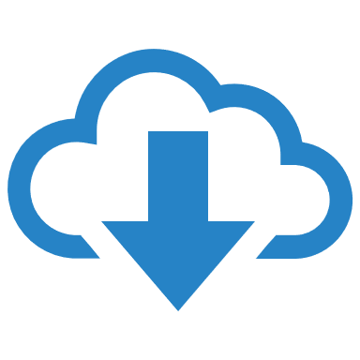





Deployment
v1
v2
Deployment
Replica Set
POD
POD
POD
POD
POD
POD
POD
POD
POD
Notes:
For a minute, let us forget about PODs and replicasets and other kubernetes concepts and talk about how you might want to deploy your application in a production environment. Say for example <click> you have a web server that needs to be deployed in a production environment. You need not ONE, <click> but many such instances of the web server running for obvious reasons.
Secondly, <click> when newer versions of application builds become available on the docker registry, you would like to UPGRADE your docker instances seamlessly.
However, when you upgrade your instances, you do not want to upgrade all of them at once as we just did. This may impact users accessing our applications, <click> so you may want to upgrade them one after the other. And that kind of upgrade is known as Rolling Updates.
Suppose one of the upgrades you performed resulted in an unexpected error and you are asked to undo the recent update. You would like to be able to <click> rollBACK the changes that were recently carried out.
Finally, say for example you would like to make multiple changes to your environment such as upgrading the underlying WebServer versions, as well as scaling your environment and also modifying the resource allocations etc. You do not want to apply each change immediately after the command is run, instead you would like to apply a <click> pause to your environment, make the changes and then resume <click> so that all changes are rolled-out together.
<click> All of these capabilities are available with the kubernetes Deployments.
<click> So far in this course we discussed about PODs, which deploy single instances of our application such as the web application in this case. Each container is encapsulated in PODs. <click> Multiple such PODs are deployed using Replication Controllers or Replica Sets. <click> And then comes Deployment which is a kubernetes object that comes higher in the hierarchy. The deployment provides us with capabilities to upgrade the underlying instances seamlessly using rolling updates, undo changes, and pause and resume changes to deployments.

Slide 72
Definition
deployment-definition.yml
apiVersion: kind: metadata:
spec:
apps/v1
ReplicaSet
Deployment
name: myapp-deployment labels: app: myapp
type: front-end
> kubectl create –f deployment-definition.yml
deployment "myapp-deployment" created
template:
> kubectl get deployments
metadata:
name: myapp-pod labels: app: myapp
type: front-end
spec:
containers: - name: nginx-container
image: nginx
NAME DESIRED CURRENT UP-TO-DATE AVAILABLE AGE
myapp-deployment 3 3 3 3 21s
> kubectl get replicaset
NAME DESIRED CURRENT READY AGE
myapp-deployment-6795844b58 3 3 3 2m
> kubectl get pods
3
replicas:
NAME READY STATUS RESTARTS AGE
myapp-deployment-6795844b58-5rbjl 1/1 Running 0 2m
myapp-deployment-6795844b58-h4w55 1/1 Running 0 2m
myapp-deployment-6795844b58-lfjhv 1/1 Running 0 2m
selector:
matchLabels:
type: front-end
Notes:
So how do we create a deployment. <click> As with the previous components, we first create a deployment definition file. The contents of the deployment-definition file are exactly similar to the replicaset definition file, except for the kind, which is now going to be Deployment.
If we walk through the contents of the file it has an apiVersion which is apps/v1, metadata which has name and labels and a spec that has template, replicas and selector. The template has a POD definition inside it.
<click> Once the file is ready run the kubectl create command and specify deployment definition file. <click> Then run the kubectl get deployments command to see the newly created deployment. The deployment automatically creates a replica set. <click> So if you run the kubectl get replcaset command you will be able to see a new replicaset in the name of the deployment. <click> The replicasets ultimately create pods, so if you run the kubectl get pods command you will be able to see the pods with the name of the deployment and the replicaset.
So far there hasn’t been much of a difference between replicaset and deployments, except for the fact that deployments created a new kubernetes object called deployments. We will see how to take advantage of the deployment using the use cases we discussed in the previous slide in the upcoming lectures.

Slide 73
commands
> kubectl get all
NAME DESIRED CURRENT UP-TO-DATE AVAILABLE AGE
deploy/myapp-deployment 3 3 3 3 9h
NAME DESIRED CURRENT READY AGE
rs/myapp-deployment-6795844b58 3 3 3 9h
NAME READY STATUS RESTARTS AGE
po/myapp-deployment-6795844b58-5rbjl 1/1 Running 0 9h
po/myapp-deployment-6795844b58-h4w55 1/1 Running 0 9h
po/myapp-deployment-6795844b58-lfjhv 1/1 Running 0 9h
Notes:
To see all the created objects at once run the kubectl get all command.

Slide 74
Demo
Deployment
Notes:
That’s it for this lecture. We will now head over to a Demo and I will see you in the next lecture.

Slide 75
Demo
Deployment
Notes:
That’s it for this lecture. We will now head over to a Demo and I will see you in the next lecture.

Slide 76
Networking 101
Gagandeep
Notes:
Hello and welcome to this lecture. My name is Gagandeep Singh and we are learning Kubernetes for Beginners. In this lecture we will discuss about Networking in kubernetes.

Slide 77
Kubernetes Networking - 101
My System
IP Address is assigned to a POD
192.168.1.10
Node
192.168.1.2
192.168.1.2
Minikube Node
10.244.0.0
POD
10.244.0.3
POD
10.244.0.2
POD
10.244.0.4
Notes:
Let us look at the very basics of networking in Kubernetes. <click> We will start with a single node kubernetes cluster. The node has an IP address, say it is 192.168.1.2 in this case. This is the IP address we use to access the kubernetes node, SSH into it etc. On a side note, <click> remember if you are using a MiniKube setup, then I am talking about the IP address of the minikube virtual machine inside your Hypervisor. Your laptop may be having a different IP like 192.168.1.10. So its important to understand how VMs are setup. <click>
So on the single node kubernetes cluster we have created a Single POD. As you know a POD hosts a container. Unlike in the docker world were an IP address is always assigned to a Docker CONTAINER, <click>
in Kubernetes the IP address is assigned to a POD. Each POD in kubernetes gets its own internal IP Address. In this case its in the range 10.244 series and the IP assigned to the POD is 10.244.0.2. So how is it getting this IP address? When Kubernetes is initially configured it creates an internal private network with the address 10.244.0.0 <click>
and all PODs are attached to it. <click> When you deploy multiple PODs, they all get a separate IP assigned. The PODs can communicate to each other through this IP. But accessing other PODs using this internal IP address MAY not be a good idea as its subject to change when PODs are recreated. We will see BETTER ways to establish communication between PODs in a while. For now its important to understand how the internal networking works in kubernetes.

Slide 78
Cluster Networking
All containers/PODs can communicate to one another without NAT
All nodes can communicate with all containers and vice-versa without NAT
Kubernetes Cluster
Node
192.168.1.2
Node
192.168.1.3
10.244.0.0
10.244.0.0
POD
10.244.0.2
POD
10.244.0.2
Notes:
So it’s all easy and simple to understand when it comes to networking on a single node. But how does it work when you have multiple nodes in a cluster? In this case we have two nodes running kubernetes and they have IP addresses 192.168.1.2 and 192.168.1.3 assigned to them. Note that they are not part of the same cluster yet. <click> Each of them has a single POD deployed. As discussed in the previous slide these pods are attached to an internal network and they have their own IP addresses assigned. HOWEVER, if you look at the network addresses, <click> you can see that they are the same. The two networks have an address 10.244.0.0 and the PODs deployed have the same address too.
<click> This is NOT going to work well when the nodes are part of the same cluster. The PODs have the same IP addresses assigned to them and that will lead to IP conflicts in the network. Now that’s ONE problem. When a kubernetes cluster is SETUP, kubernetes does NOT automatically setup any kind of networking to handle these issues. As a matter of fact, kubernetes expects US to setup networking to meet certain fundamental requirements. Some of these are that <click> all the containers or PODs in a kubernetes cluster MUST be able to communicate with one another without having to configure NAT. <click> All nodes must be able to communicate with containers and all containers must be able to communicate with the nodes in the cluster. Kubernetes expects US to setup a networking solution that meets these criteria.

Slide 79
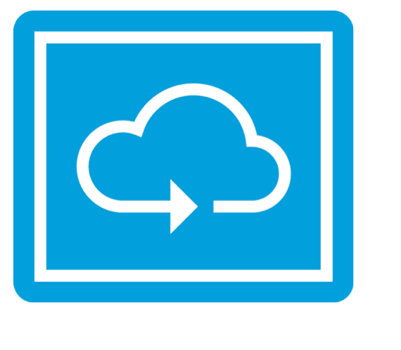
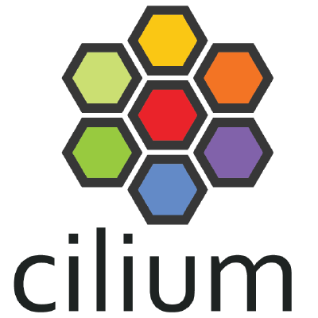
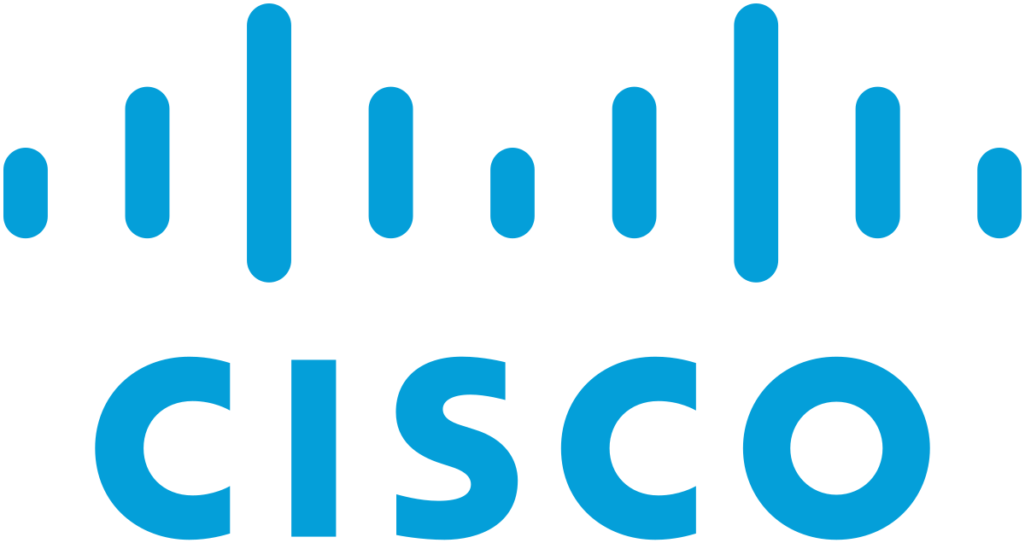
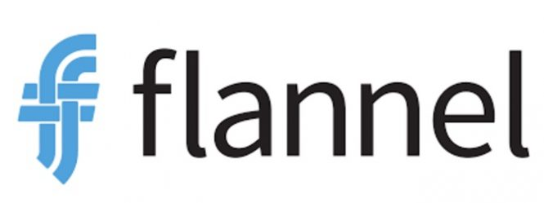
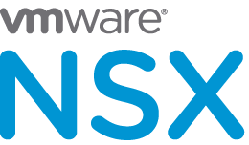
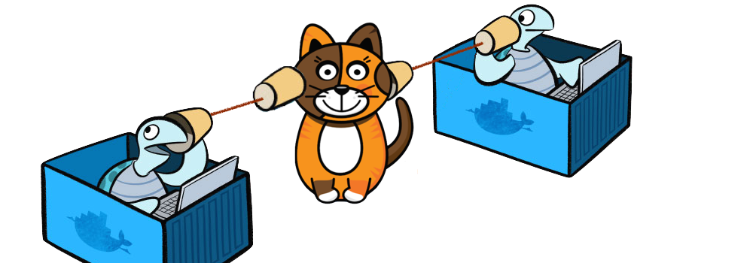
Notes:
Fortunately, we don’t have to set it up ALL on our own as there are multiple pre-built solutions available. Some of them are the cisco ACI networks, Cilium, Big Cloud Fabric, Flannel, Vmware NSX-t and Calico. Depending on the platform you are deploying your Kubernetes cluster on you may use any of these solutions. For example, if you were setting up a kubernetes cluster from scratch on your own systems, you may use any of these solutions like Calico, Flannel etc. If you were deploying on a Vmware environment NSX-T may be a good option. If you look at the play-with-k8s labs they use WeaveNet. In our demos in the course we used Calico. Depending on your environment and after evaluating the Pros and Cons of each of these, you may chose the right networking solution.

Slide 80
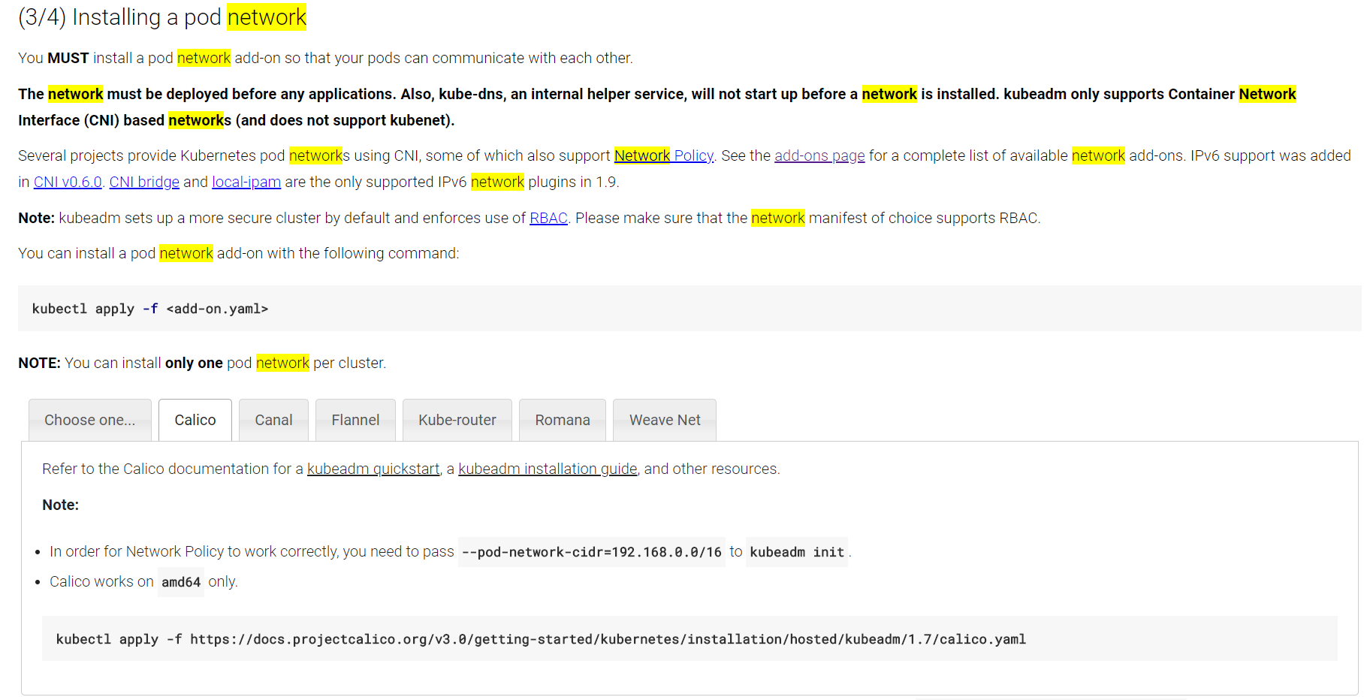
Cluster Networking Setup
Notes:
If you go back and look at the demo were we setup a kubernetes cluster initially, we setup networking based on Calico. It only took us a few set of commands to get it setup. So its pretty easy.

Slide 81
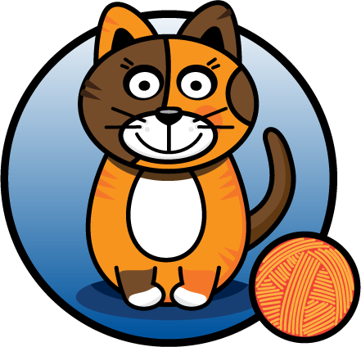
Cluster Networking
Kubernetes Cluster
Node
192.168.1.2
Node
192.168.1.3
10.244.1.0
Routing
10.244.2.0
POD
10.244.1.2
POD
10.244.2.2
Notes:
So back to our cluster, with the <click> Calico networking setup, it now manages the networks and Ips in my nodes and assigns a different network address for each network in the nodes. This creates a virtual network of all PODs and nodes were they are all assigned a unique IP Address. And by using simple routing techniques the cluster networking enables communication between the different PODs or Nodes to meet the networking requirements of kubernetes. Thus all PODs can now communicate to each other using the assigned IP addresses.

Slide 82
Demo
Networking
Notes:
That’s it for this lecture. We will now head over to a Demo and I will see you in the next lecture.

Slide 83
Services
Gagandeep
Notes:
Hello and welcome to this lecture. My name is Gagandeep Singh and we are learning Kubernetes for Beginners. In this lecture we will discuss about Kubernetes Services.

Slide 84
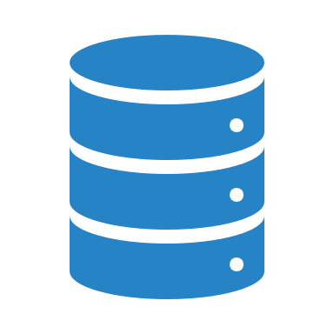
Services
Services
Services
Services
Services
Notes:
Kubernetes Services enable communication between various components within and outside of the application. Kubernetes Services helps us connect applications together with other applications or users. For example, our application has groups of PODs running various sections, such as a group for serving front-end load to users, another group running back-end processes, and a third group connecting to an external data source. It is Services that enable connectivity between these groups of PODs. <click> Services enable the front-end application to be made available to users, <click> it helps communication between back-end and front-end PODs, and <click> helps in establishing connectivity to an external data source. Thus services enable loose coupling between microservices in our application.

Slide 85

Service
Node
192.168.1.2
10.244.0.0
SSH
>curl http://10.244.0.2
?
:30008
Service
>curl http://192.168.1.2
30008
Hello World!
Hello World!
POD
10.244.0.2
192.168.1.10
Notes:
Let’s take a look at one use case of Services. So far we talked about how PODs communicate with each other through internal networking. Let’s look at some other aspects of networking in this lecture. Let’s start with external communication. So we deployed our POD having a web application running on it. How do WE as an external user access the web page? First of all, lets look at the existing setup. The Kubernetes Node has an IP address and that is 192.168.1.2. <click> My laptop is on the same network as well, so it has an IP address 192.168.1.10. The internal POD network is in the range 10.244.0.0 and the POD has an IP 10.244.0.2. Clearly, I cannot ping or access the POD at address 10.244.0.2 as its in a separate network. So what are the options to see the webpage?
First, <click> if we were to SSH into the kubernetes node at 192.168.1.2, from the node, we would be able to access the POD’s webpage by doing a curl or if the node has a GUI, we could fire up a browser and see the webpage in a browser following the address http://10.244.0.2. <click> But this is from inside the kubernetes Node and that’s not what I really want. <click> I want to be able to access the web server from my own laptop without having to SSH into the node and simply by accessing the IP of the kubernetes node. <click> So we need something in the middle to help us map requests to the node from our laptop through the node to the POD running the web container.
That is where the kubernetes service comes into play. The kubernetes service is an object just like PODs, Replicaset or Deployments that we worked with before. One of its use case is to listen to a port on the Node and forward requests on that port to a port on the POD running the web application. This type of service is known as a NodePort service because the service listens to a port on the Node and forwards requests to PODs. There are other kinds of services available which we will now discuss.

Slide 86
Services Types
NodePort
ClusterIP
LoadBalancer
Notes:
The first one is what we discussed already – NodePort <click> were the service makes an internal POD accessible on a Port on the Node. The second is ClusterIP – <click> and in this case the service creates a virtual IP inside the cluster to enable communication between different services such as a set of front-end servers to a set of backend-servers. The third type is a LoadBalancer, were it provisions a load balancer for our service in supported cloud providers. A good example of that would be to distribute load across different web servers. We will now look at Each of these in a bit more detail along with some Demos.

Slide 87
NodePort
Notes:
In this lecture we will discuss about the NodePort Kubernetes Service.

Slide 88
Service - NodePort
Node
192.168.1.2
10.244.0.0
?
>curl http://192.168.1.2:30008
30008
Service
Hello World!
POD
10.244.0.2
192.168.1.10
Notes:
Getting back to NodePort, few slides back we discussed about external access to the application. We said that a Service can help us by mapping a port on the Node to a port on the POD.

Slide 89
Service - NodePort
Node
Service
10.106.1.12
2
Port
3
NodePort
30008
80
1
TargetPort
80
Range:
30000 - 32767
POD
10.244.0.2
Notes:
Let’s take a closer look at the Service. If you look at it, there are 3 ports involved. The port on the POD were the actual web server is running is port <click> 80. And it is referred to as the targetPort, because that is were the service forwards the requests to. The second port is the port on the <click> service itself. It is simply referred to as the port. Remember, these terms are from the viewpoint of the service. The service is in fact like a virtual server inside the node. Inside the cluster it has its own IP address. And that IP address is called the <clik> Cluster-IP of the service. And finally we have the port on the Node itself <click> which we use to access the web server externally. And that is known as the NodePort. As you can see it is 30008. That is because NodePorts can only be in a valid range which is from 30000 to 32767.

Slide 90
Service - NodePort
service-definition.yml
Node
apiVersion: kind: metadata:
spec:
v1
Service
Service
name: myapp-service
10.106.1.12
2
Port
3
NodePort
30008
80
1
TargetPort
80
type: NodePort
ports:
- targetPort: 80
port: 80
nodePort: 30008
Range:
30000 - 32767
POD
10.244.0.2
*
Notes:
Let us now look at how to create the service. Just like how we created a Deployment, ReplicaSet or Pod, we will use a definition file to create a service.
The high level structure of the file remains the same. <click> As before we have apiVersion, kind, metadata and spec sections. <click> The apiVersion is going to be v1. <click> The kind is ofcourse service. <click> The metadata will have a name and that will be the name of the service. It can have labels, but we don’t need that for now. Next we have spec. and as always this is the most crucial part of the file as this is were we will be defining the actual services and this is the part of a definition file that differs between different objects. <click> In the spec section of a service we have type and ports. The type refers to the type of service we are creating. As discussed before it could be ClusterIP, NodePort, or LoadBalancer. In this case since we are creating a NodePort we will set it as NodePort. The next part of spec is ports. This is were we input information regarding what we discussed on the left side of this screen. The first type of port is the targetPort, <click> which we will set to 80. The next one is simply port, <click> which is the port on the service object and we will set that to 80 as well. The third is NodePort <click> which we will set to 30008 or any number in the valid range. Remember that out of these, the only mandatory field is port <click>. If you don’t provide a targetPort it is assumed to be the same as port and if you don’t provide a nodePort a free port in the valid range between 30000 and 32767 is automatically allocated. Also note that ports is an array. So note the dash <click> under the ports section that indicate the first element in the array. You can have multiple such port mappings within a single service.
So we have all the information in, but something is really missing. There is nothing here in the definition file that connects the service to the POD. We have simply specified the targetPort but we didn’t mention the targetPort on which POD. There could be 100s of other PODs with web services running on port 80. So how do we do that?
As we did with the replicasets previously and a technique that you will see very often in kubernetes, we will use labels and selectors to link these together. We know that the POD was created with a label. We need to bring that label into this service definition file.

Slide 91
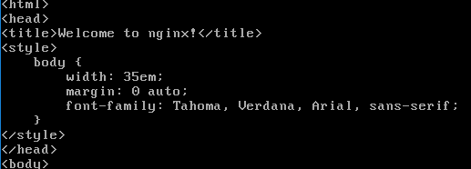
Service - NodePort
service-definition.yml
pod-definition.yml
apiVersion: kind: metadata:
spec:
v1
v1
apiVersion: kind:
metadata:
name: myapp-pod labels:
spec:
containers: - name: nginx-container
image: nginx
> kubectl create –f service-definition.yml
Service
Pod
service "myapp-service" created
name: myapp-service
> kubectl get services
NAME TYPE CLUSTER-IP EXTERNAL-IP PORT(S) AGE
kubernetes ClusterIP 10.96.0.1 <none> 443/TCP 16d
myapp-service NodePort 10.106.127.123 <none> 80:30008/TCP 5m
app: myapp
type: front-end
type: NodePort
ports:
- targetPort: 80
port: 80
nodePort: 30008
> curl http://192.168.1.2:30008
selector:
Notes:
So we have a new property in the spec section and that is <click> selector. Under the selector provide a list of labels to identify the POD. <click> For this refer to the pod-definition file used to create the POD. <click> Pull the labels from the pod-definition file and place it under the selector section. This links the service to the pod. <click> Once done create the service using the kubectl create command and input the service-definition file and there you have the service created.
To see the created service, run the kubectl get services command that lists the services, their cluster-ip and the mapped ports. The type is NodePort as we created and the port on the node automatically assigned is 32432. We can now use this port to access the web service using curl or a web browser.

Slide 92
Service - NodePort
30008
Node
192.168.1.2
selector: app: myapp
Service
Algorithm: Random
SessionAffinity: Yes
POD
POD
POD
10.244.0.4
10.244.0.3
10.244.0.2
labels: app: myapp
Notes:
So far we talked about a service mapped to a single POD. But that’s not the case all the time, what do you do when you have multiple PODs? <click> In a production environment you have multiple instances of your web application running for high-availability and load balancing purposes.
In this case we have multiple similar PODs running our web application. <click> They all have the same labels with a key app set to value myapp. The same label is used as a selector during the creation of the service. So when the service is created, it looks for matching PODs with the labels and finds 3 of them. <click> The service then automatically selects all the 3 PODs as endpoints to forward the external requests coming from the user. You don’t have to do any additional configuration to make this happen. <click> And if you are wondering what algorithm it uses to balance load, it uses a random algorithm. Thus the service acts as a built-in load balancer to distribute load across different PODs.

Slide 93
Service - NodePort
>curl http://192.168.1.2:30008
>curl http://192.168.1.3:30008
>curl http://192.168.1.4:30008
30008
30008
30008
Node
Node
Node
192.168.1.2
192.168.1.3
192.168.1.4
Service
POD
POD
10.244.0.3
POD
10.244.0.4
10.244.0.2
Notes:
And finally, lets look at what happens when the PODs are distributed across multiple nodes. In this case we have the web application on PODs on separate nodes in the cluster. When we create a service , without us having to do ANY kind of additional configuration, <click> kubernetes creates a service that spans across all the nodes in the cluster and maps the target port to the SAME NodePort on all the nodes in the cluster. <click> This way you can access your application using the IP of any node in the cluster and using the same port number which in this case is 30008.
To summarize – in ANY case weather it be a single pod in a single node, multiple pods on a single node, multiple pods on multiple nodes, the service is created exactly the same without you having to do any additional steps during the service creation. When PODs are removed or added the service is automatically updated making it highly flexible and adaptive. Once created you won’t typically have to make any additional configuration changes.

Slide 94
Demo
Service - NodePort
Notes:
That’s it for this lecture, head over to the demo and I will see you in the next lecture.

Slide 95
ClusterIP
Gagandeep
Notes:
In this lecture we will discuss about the Kubernetes Service - ClusterIP .

Slide 96
ClusterIP
POD
POD
10.244.0.3
POD
10.244.0.4
10.244.0.2
front-end
back-end
POD
POD
10.244.0.7
POD
10.244.0.6
10.244.0.5
back-end
redis
POD
POD
10.244.0.8
10.244.0.10
10.244.0.5
POD
10.244.0.9
redis
Notes:
A full stack web application typically has different kinds of PODs hosting different parts of an application. <click> You may have a number of PODs running a front-end web server, another set of PODs running a backend server, a set of PODs running a key-value store like Redis, another set of PODs running a persistent database like MySQL etc. <click> The web front-end servers need to connect to the backend-workers and the backend-workers need to connect to database as well as the redis services. So what IS the right way to establish connectivity between these PODs?
The PODs all have an IP address assigned to them as we can see on the screen. But these Ips as we know are not static, these PODs can go down anytime and new PODs are created all the time – and so you CANNOT rely on these IP addresses for internal communication within the application. Also what if the first front-end POD at 10.244.0.3 need to connect to a backend service? Which of the 3 would it go to and who makes that decision?
A kubernetes service <click> can help us group these PODs together and provide a single interface to access the PODs in a group. For example a service created for the backend PODs will help group all the backend PODs together and provide a single interface for other PODs to access this service. The requests are forwarded to one of the PODs under the service randomly. Similarly, <click> create additional services for Redis and allow the backend PODs to access the redis system through this service. This enables us to easily and effectively deploy a microservices based application on kubernetes cluster. Each layer can now scale or move as required without impacting communication between the various services. Each service gets an IP and name assigned to it inside the cluster and that is the name that should be used by other PODs to access the service. <click> This type of service is known as ClusterIP.

Slide 97
service-definition.yml
pod-definition.yml
apiVersion: kind: metadata:
spec:
v1
v1
apiVersion: kind:
metadata:
name: myapp-pod labels:
spec:
containers: - name: nginx-container
image: nginx
> kubectl create –f service-definition.yml
Service
Pod
service “back-end" created
name: back-end
> kubectl get services
NAME TYPE CLUSTER-IP EXTERNAL-IP PORT(S) AGE
kubernetes ClusterIP 10.96.0.1 <none> 443/TCP 16d
back-end ClusterIP 10.106.127.123 <none> 80/TCP 2m
app: myapp
type: back-end
type: ClusterIP
ports:
- targetPort: 80
port: 80
selector:
Notes:
To create such a service, as always, use a definition file. In the service definition file , first use the default template which has apiVersion, kind, metadata and spec. The apiVersion is v1 <click> , kind is Service and we will give a name to our service – we will call it back-end. <click> Under Specification we have type and ports. The type is ClusterIP. In fact, ClusterIP is the default type, so even if you didn’t specify it, it will automatically assume it to be ClusterIP. Under ports we have a targetPort and port. The target port is the port were the back-end is exposed, which in this case is 80. And the port is were the service is exposed. Which is 80 as well. <click> To link the service to a set of PODs, we use selector.
We will refer to the pod-definition file <click> and copy the labels from it and move it under selector. And that should be it. <click> We can now create the service using the kubectl create command and then check its status using <click> the kubectl get services command. The service can be accessed by other PODs using the ClusterIP or the service name.

Slide 98
Demo
Service - NodePort
Notes:
That’s it for this lecture, head over to the demo and I will see you in the next lecture.

Slide 99
References
https://kubernetes.io/docs/concepts/services-networking/dns-pod-service/

Slide 100
Rollout and Versioning
Revision 1
nginx:1.7.0
nginx:1.7.0
nginx:1.7.0
nginx:1.7.0
nginx:1.7.0
nginx:1.7.0
nginx:1.7.0
nginx:1.7.0
nginx:1.7.0
Revision 2
nginx:1.7.1
nginx:1.7.1
nginx:1.7.1
nginx:1.7.1
nginx:1.7.1
nginx:1.7.1
nginx:1.7.1
nginx:1.7.1
nginx:1.7.1
Notes:
Before we look at how we upgrade our application, let’s try to understand Rollouts and Versioning in a deployment. Whenever you create a new deployment or upgrade the images in an existing deployment it triggers a Rollout. A rollout is the process of gradually deploying or upgrading your application containers. When you first create a deployment, it triggers a rollout. <click> A new rollout creates a new Deployment revision. Let’s call it revision 1. In the future when the application is upgraded <click> – meaning when the container version is updated to a new one – a new rollout is triggered and a new deployment revision is created named Revision 2. This helps us keep track of the changes made to our deployment and enables us to rollback to a previous version of deployment if necessary.

Slide 101
Rollout Command
> kubectl rollout status deployment/myapp-deployment
Waiting for rollout to finish: 0 of 10 updated replicas are available...
Waiting for rollout to finish: 1 of 10 updated replicas are available...
Waiting for rollout to finish: 2 of 10 updated replicas are available...
Waiting for rollout to finish: 3 of 10 updated replicas are available...
Waiting for rollout to finish: 4 of 10 updated replicas are available...
Waiting for rollout to finish: 5 of 10 updated replicas are available...
Waiting for rollout to finish: 6 of 10 updated replicas are available...
Waiting for rollout to finish: 7 of 10 updated replicas are available...
Waiting for rollout to finish: 8 of 10 updated replicas are available...
Waiting for rollout to finish: 9 of 10 updated replicas are available...
deployment "myapp-deployment" successfully rolled out
> kubectl rollout history deployment/myapp-deployment
deployments "myapp-deployment"
REVISION CHANGE-CAUSE
1 <none>
2 kubectl apply --filename=deployment-definition.yml --record=true
Notes:
You can see the status of your rollout by running the command: <click> kubectl rollout status followed by the name of the deployment.
To see the revisions and history of rollout <click> run the command kubectl rollout history followed by the deployment name and this will show you the revisions.

Slide 102

Deployment Strategy
Application
Down
Recreate
nginx:1.7.0
nginx:1.7.0
nginx:1.7.0
nginx:1.7.0
nginx:1.7.0
nginx:1.7.1
nginx:1.7.1
nginx:1.7.1
nginx:1.7.1
nginx:1.7.1
Rolling
Update
nginx:1.7.0
nginx:1.7.1
nginx:1.7.0
nginx:1.7.1
nginx:1.7.0
nginx:1.7.1
nginx:1.7.0
nginx:1.7.1
nginx:1.7.0
nginx:1.7.1
Notes:
There are two types of deployment strategies. Say for example you have 5 replicas of your web application instance deployed. One way to upgrade these to a newer version is to destroy all of these and then create newer versions of application instances. <click> Meaning first, destroy the 5 running instances and then deploy 5 new instances of the new application version. The problem with this as you can imagine, <click> is that during the period after the older versions are down and before any newer version is up, the application is down and inaccessible to users. <click> This strategy is known as the Recreate strategy, and thankfully this is NOT the default deployment strategy.
<click> The second strategy is were we do not destroy all of them at once. <click> Instead we take down the older version and bring up a newer version one by one. This way the application never goes down and the upgrade is seamless.
Remember, if you do not specify a strategy while creating the deployment, it will assume it to be Rolling Update. In other words, RollingUpdate is the default Deployment Strategy.

Slide 103
Kubectl apply
deployment-definition.yml
apiVersion: kind: metadata:
spec:
apps/v1
Deployment
name: myapp-deployment labels: app: myapp
type: front-end
> kubectl apply –f deployment-definition.yml
deployment "myapp-deployment" configured
template:
metadata:
name: myapp-pod labels: app: myapp
type: front-end
spec:
containers: - name: nginx-container
image: nginx
> kubectl set image deployment/myapp-deployment \ nginx=nginx:1.9.1
deployment "myapp-deployment" image is updated
:1.7.1
3
replicas:
selector:
matchLabels:
type: front-end
Notes:
So we talked about upgrades. How exactly DO you update your deployment? When I say update it could be different things such as updating your application version by updating the version of docker containers used, updating their labels or updating the number of replicas etc. <click> Since we already have a deployment definition file it is easy for us to modify this file. Once we make the necessary changes, <click> we run the kubectl apply command to apply the changes. A new rollout is triggered and a new revision of the deployment is created.
But there is ANOTHER way to do the same thing. You could use the kubectl set image command to update the image of your application. But remember, doing it this way will result in the deployment-definition file having a different configuration. So you must be careful when using the same definition file to make changes in the future.

Slide 104
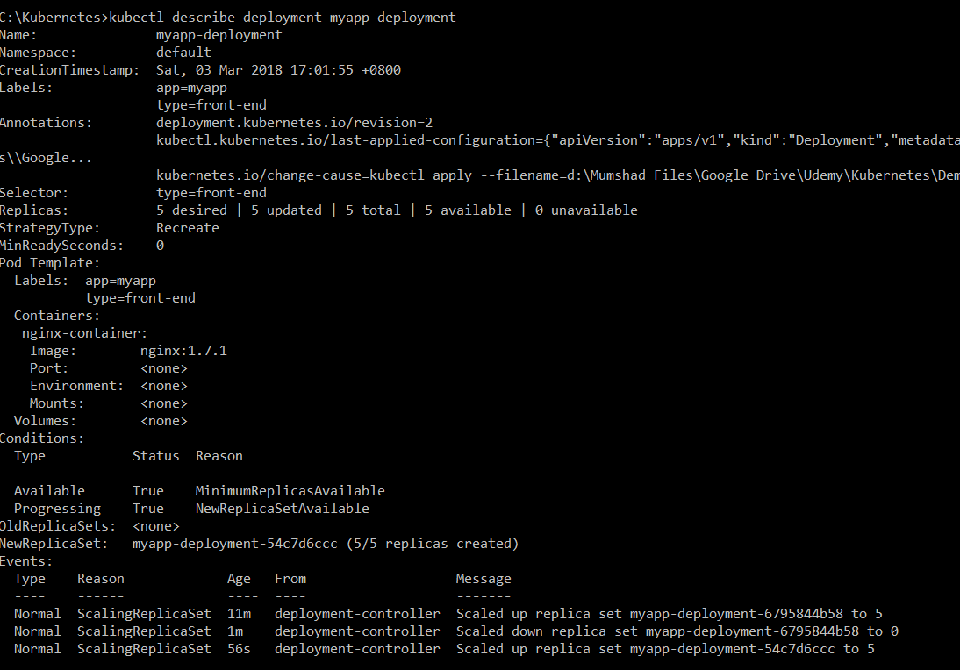
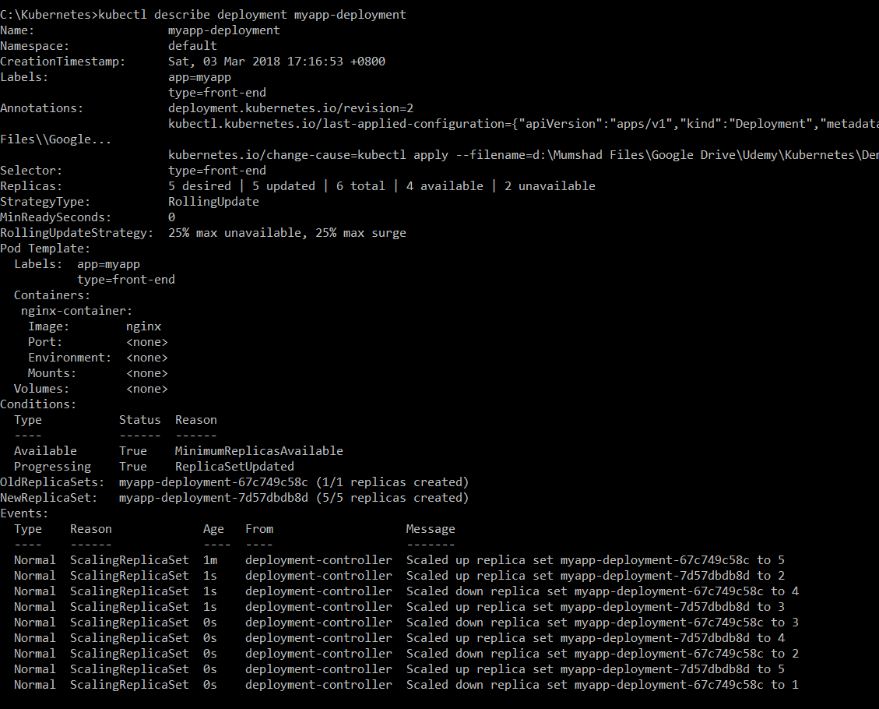
Recreate RollingUpdate
Notes:
The difference between the recreate and rollingupdate strategies can also be seen when you view the deployments in detail. Run the kubectl describe deployment command to see detailed information regarding the deployments. <click> You will notice when the Recreate strategy was used the events indicate that the old replicaset was scaled down to <click> 0 first and the new replica set scaled up to 5. <click> However when the RollingUpdate strategy was used the old replica set was scaled down one at a time simultaneously scaling up the new replica set one at a time.

Slide 105
Upgrades
Deployment
Replica Set - 1
Replica Set - 2
POD
POD
POD
POD
POD
POD
POD
POD
POD
POD
> kubectl get replicasets
NAME DESIRED CURRENT READY AGE
myapp-deployment-67c749c58c 0 0 0 22m
myapp-deployment-7d57dbdb8d 5 5 5 20m
Notes:
Let’s look at how a deployment performs an upgrade under the hoods. <click> When a new deployment is created, say to deploy 5 replicas, it first creates a <click> Replicaset automatically, <click> which in turn creates the number of PODs required to meet the number of replicas. When you upgrade your application as we saw in the previous slide, the kubernetes deployment object creates a NEW <click> replicaset under the hoods and starts deploying the containers there. <click> At the same time taking down the PODs in the old replica-set following a RollingUpdate strategy.
This can be seen when you try to list the replicasets using the kubectl get replicasets command. Here we see the old replicaset with 0 PODs and the new replicaset with 5 PODs.

Slide 106
Rollback
> kubectl get replicasets
> kubectl get replicasets
NAME DESIRED CURRENT READY AGE
myapp-deployment-67c749c58c 0 0 0 22m
myapp-deployment-7d57dbdb8d 5 5 5 20m
NAME DESIRED CURRENT READY AGE
myapp-deployment-67c749c58c 5 5 5 22m
myapp-deployment-7d57dbdb8d 0 0 0 20m
Deployment
Replica Set - 1
Replica Set - 2
POD
POD
POD
POD
POD
POD
POD
POD
POD
POD
> kubectl rollout undo deployment/myapp-deployment
deployment “myapp-deployment” rolled back
Notes:
Say for instance once you upgrade your application, you realize something isn’t very right. Something’s wrong with the new version of build you used to upgrade. So you would like to rollback your update. Kubernetes deployments allow you to rollback to a previous revision. <click> To undo a change run the command kubectl rollout undo followed by the name of the deployment. <click> The deployment will then destroy the PODs in the new replicaset and bring the older ones up in the old replicaset. And your application is back to its older format.
When you compare the output of the kubectl get replicasets command, <click> before and after the rollback, you will be able to notice this difference. <click> Before the rollback the first replicaset had 0 PODs and the new replicaset had 5 PODs and this is reversed after the rollback is finished.

Slide 107
kubectl run
> kubectl run nginx --image=nginx
deployment "nginx" created
Notes:
And finally let’s get back to one of the commands we ran initially when we learned about PODs for the first time. <click> We used the kubectl run command to create a POD. This command infact creates a deployment and not just a POD. This is why the output of the command says Deployment nginx created. This is another way of creating a deployment by only specifying the image name and not using a definition file. A replicaset and pods are automatically created in the backend. Using a definition file is recommended though as you can save the file, check it into the code repository and modify it later as required.

Slide 108
Summarize Commands
Create
> kubectl create –f deployment-definition.yml --record=true
Get
> kubectl get deployments
> kubectl apply –f deployment-definition.yml
Update
> kubectl set image deployment/myapp-deployment nginx=nginx:1.9.1
Status
> kubectl rollout status deployment/myapp-deployment
> kubectl rollout history deployment/myapp-deployment
Rollback
> kubectl rollout undo deployment/myapp-deployment
Notes:
To summarize the commands real quick, use the kubectl create command to create the deployment, get deployments command to list the deployments, apply and set image commands to update the deployments, rollout status command to see the status of rollouts and rollout undo command to rollback a deployment operation.

Slide 109
HEALTHCHECKS
Gagandeep
Notes:
Hello and welcome to this lecture on Kubernetes PODs. My name is Gagandeep Singh and we are learning Kubernetes for Beginners. In this lecture we will discuss about Kubernetes PODs.

Slide 110
HEALTH CHECKS
If your application malfunctions, the pod and container can still be running, but the application might not work anymore.
To detect and resolve problems with your application, you can run healthchecks:
Two different types of HC:
- Running a command in the container periodically
- Periodic checks on a URL (HTTP)
the typical production application behind a load-balancer should always have heathchecks implemented in some way to ensure availability and resiliency of the app
Gagandeep
Notes:
Before we head into understanding PODs, we would like to assume that the following have been setup already. At this point, we assume that the application is already developed and built into Docker Images and it is availalble on a Docker repository like Docker hub, so kubernetes can pull it down. We also assume that the Kubernetes cluster has already been setup and is working. This could be a single-node setup or a multi-node setup, doesn’t matter. All the services need to be in a running state.

Slide 111
HEALTH CHECKS
apiVersion: v1
kind: Pod
metadata:
name: myapp-podmonitor
labels:
app: myapp
type: front-end
spec:
containers:
- name: httpd-container
image: httpd
ports:
- name: httpd-port
containerPort: 8080
livenessProbe:
httpGet:
path: /
port: 8080
initialDelaySeconds: 15
timeoutSeconds: 30
nodeSelector:
hardware: high-spec
kubectl get nodes
kubectl get nodes --show-labels
kubectl create -f <yamlfile>
kubectl describe pod (you can edit the values)
kubectl edit pod <POD-NAME>
Notes:
Before we head into understanding PODs, we would like to assume that the following have been setup already. At this point, we assume that the application is already developed and built into Docker Images and it is availalble on a Docker repository like Docker hub, so kubernetes can pull it down. We also assume that the Kubernetes cluster has already been setup and is working. This could be a single-node setup or a multi-node setup, doesn’t matter. All the services need to be in a running state.

Slide 112
Static Pod
Individual pods on Workers
Gagandeep
Notes:
In this lecture we will talk about updates and rollbacks in a Deployment.

Slide 113
Static Pods
Static Pods are managed directly by the kubelet daemon on a specific node, without the API server observing them.
Unlike Pods that are managed by the control plane (for example, a Deployment); instead, the kubelet watches each static Pod (and restarts it if it fails).
Static Pods are always bound to one Kubelet on a specific node.
The kubelet automatically tries to create a mirror Pod on the Kubernetes API server for each static Pod. This means that the Pods running on a node are visible on the API server, but cannot be controlled from there.
The Pod names will be suffixed with the node hostname with a leading hyphen.

Slide 114
Static Pods
K8S version >1.21.x:
Put pod.yaml file under below path on node to get it started automatically:
/etc/kubernetes/manifests/
For previous versions:
1) Create a directory i.e. /etc/kubelet.d/
2) Put yaml files into it
3) Run below command:
KUBELET_ARGS="--cluster-dns=10.254.0.10 --cluster-domain=kube.local --pod-manifest-path=/etc/kubelet.d/“
4) Restart kubelet via
systemctl restart kubelet

Slide 115
Init Container
Start before others
Gagandeep
Notes:
In this lecture we will talk about updates and rollbacks in a Deployment.

Slide 116
Init Containers
What if you need one container in pod to run successfully, before other containers get started in it to setup the base (like Filesystem, Binaries availability/Dependency etc)?
A Pod can have multiple containers running apps within it, but it can also have one or more init containers, which are run before the app containers are started.
Init containers are exactly like regular containers, except:
Init containers always run to completion.
Each init container must complete successfully before the next one starts.
If a Pod's init container fails, the kubelet repeatedly restarts that init container until it succeeds.
However, if the Pod has a restartPolicy of Never, and an init container fails during startup of that Pod, Kubernetes treats the overall Pod as failed.

Slide 117
Init Containers
https://kubernetes.io/docs/concepts/workloads/pods/init-containers/

Slide 118
DaemonSet
Run on all Machines
Gagandeep
Notes:
In this lecture we will talk about updates and rollbacks in a Deployment.

Slide 119
DaemonSets
A DaemonSet ensures that all (or some) Nodes run a copy of a Pod. As nodes are added to the cluster, Pods are added to them. As nodes are removed from the cluster, those Pods are garbage collected. Deleting a DaemonSet will clean up the Pods it created.
Some typical uses of a DaemonSet are:
running a cluster storage daemon on every node
running a logs collection daemon on every node
running a node monitoring daemon on every node
https://kubernetes.io/docs/concepts/workloads/controllers/daemonset/

Slide 120
SECRETS
Gagandeep
Notes:
Hello and welcome to this lecture on Kubernetes PODs. My name is Gagandeep Singh and we are learning Kubernetes for Beginners. In this lecture we will discuss about Kubernetes PODs.

Slide 121
SECRETS
Secrets provides a way in K8's to distribute credentials, keys, passwords or secret data to the pods.
K8 itself used this mechanism to provide the credentials to access the internal API's
Secrets is one way to provide secrets, native to K8, other way is by using external vault services
Secrets can be used as: environment variables
or as a file in a pod ( this need volume to be mounted and volumes have the files having secrets)
First generate a Secrets using files:
echo -n "root" > ./username.txt
echo -n "password" > ./password.txt
kubectl create secret generic db-user-pass --from-file=./username.txt --from-file=./password.txt
NOTE: You can also use SSH keys
Gagandeep
Notes:
Before we head into understanding PODs, we would like to assume that the following have been setup already. At this point, we assume that the application is already developed and built into Docker Images and it is availalble on a Docker repository like Docker hub, so kubernetes can pull it down. We also assume that the Kubernetes cluster has already been setup and is working. This could be a single-node setup or a multi-node setup, doesn’t matter. All the services need to be in a running state.

Slide 122
SECRETS
apiVersion: v1
kind: Pod
metadata:
name: myapp-pod
labels:
app: myapp
type: front-end
spec:
containers:
- name: httpd-container
image: httpd
volumeMounts:
- name: cred-volume
mountPath: /etc/creds
readOnly: true
volumes:
- name: cred-volume
secret:
secretName: <Secret-Name>
echo -n "root" | base64
echo -n "password" | base64
kubectl create -f <YAML>
kubectl describe pod <POD-Name>
apiVersion: v1
kind: Secret
metadata:
name: db-secrets
type: Opaque
data:
username: cm9vdA==
password: cGFzc3dvcmQ=
Login into the container and see the secrets will be in:
/etc/creds/username
/etc/creds/password
Execute mount and you will see default secrets shared by Kubernetes: tmpfs on /run/secrets/kubernetes.io/serviceaccount type tmpfs (ro,relatime,seclabel)
kubectl create -f <yaml>
kubectl get secrets
kubectl describe secrets <Secret-Name>
Notes:
Before we head into understanding PODs, we would like to assume that the following have been setup already. At this point, we assume that the application is already developed and built into Docker Images and it is availalble on a Docker repository like Docker hub, so kubernetes can pull it down. We also assume that the Kubernetes cluster has already been setup and is working. This could be a single-node setup or a multi-node setup, doesn’t matter. All the services need to be in a running state.

Slide 123
SECRETS
apiVersion: v1
kind: Pod
metadata:
name: myapp-pod
labels:
app: myapp
type: front-end
spec:
containers:
- name: httpd-container
image: httpd
env:
- name: SECRET_USERNAME
valueFrom:
secretKeyRef:
name: db-secret
key: username
-name: SECRET_PASSWD
…………
Secrets with Environment Variables
Notes:
Before we head into understanding PODs, we would like to assume that the following have been setup already. At this point, we assume that the application is already developed and built into Docker Images and it is availalble on a Docker repository like Docker hub, so kubernetes can pull it down. We also assume that the Kubernetes cluster has already been setup and is working. This could be a single-node setup or a multi-node setup, doesn’t matter. All the services need to be in a running state.

Slide 124
ConfigMaps
Gagandeep
Notes:
Hello and welcome to this lecture on Kubernetes PODs. My name is Gagandeep Singh and we are learning Kubernetes for Beginners. In this lecture we will discuss about Kubernetes PODs.

Slide 125
ConfigMaps
Configuration parameters that are not secret, can be put in a configmap
The input is again key-value pair and can be read from any of the below methods:
- environments variables
- volumes
- Container command line parameters
A configmap can be a complete configuration file, This file can be then mounted using volumes where applications are expecting the file
This way we can change the container without changing the container directly (without changing the container image)
CREATE A CONFIG FILE
kubectl create configmap <CONFIG_MAP_NAME> --from-file=<file-name>
Then create a pod with volumes
Gagandeep
Notes:
Before we head into understanding PODs, we would like to assume that the following have been setup already. At this point, we assume that the application is already developed and built into Docker Images and it is availalble on a Docker repository like Docker hub, so kubernetes can pull it down. We also assume that the Kubernetes cluster has already been setup and is working. This could be a single-node setup or a multi-node setup, doesn’t matter. All the services need to be in a running state.

Slide 126
ConfigMaps
apiVersion: v1
kind: Pod
metadata:
name: helloworld-nginx
labels:
app: helloworld-nginx
spec:
containers:
- name: nginx
image: nginx
ports:
- containerPort: 80
volumeMounts:
- name: config-volume
mountPath: /usr/share/nginx/html
volumes:
- name: config-volume
configMap:
name: nginx-config
items:
- key: index.html
path: index.html
/usr/local/apache2/htdocs/index.html
<html><body><h1>It works again with Configmaps!</h1></body></html>
kubectl create configmap nginx-config --from-file=index.html
kubectl get configmap
kubectl get configmap -o yaml
(here you will see a key (in our case index.html) and values)
apiVersion: v1
kind: Service
metadata:
name: helloworld-nginx-service
spec:
ports:
- port: 80
protocol: TCP
selector:
app: helloworld-nginx
type: NodePort
Notes:
Before we head into understanding PODs, we would like to assume that the following have been setup already. At this point, we assume that the application is already developed and built into Docker Images and it is availalble on a Docker repository like Docker hub, so kubernetes can pull it down. We also assume that the Kubernetes cluster has already been setup and is working. This could be a single-node setup or a multi-node setup, doesn’t matter. All the services need to be in a running state.

Slide 127
PV and PVC
Persistent Storage in Kubernetes
Gagandeep
Notes:
In this lecture we will talk about updates and rollbacks in a Deployment.

Slide 128
Persistent Storage
A Persistent Volume (PV) is a piece of storage in the cluster that has been provisioned by an administrator or dynamically provisioned using Storage Classes. It is a resource in the cluster just like a node is a cluster resource. PVs are volume plugins like Volumes but have a lifecycle independent of any individual Pod that uses the PV.
A PersistentVolumeClaim (PVC) is a request for storage by a user. It is similar to a Pod. Pods consume node resources and PVCs consume PV resources. Pods can request specific levels of resources (CPU and Memory). Claims can request specific size and access modes (e.g., they can be mounted ReadWriteOnce, ReadOnlyMany or ReadWriteMany
Notes:
Before we look at how we upgrade our application, let’s try to understand Rollouts and Versioning in a deployment. Whenever you create a new deployment or upgrade the images in an existing deployment it triggers a Rollout. A rollout is the process of gradually deploying or upgrading your application containers. When you first create a deployment, it triggers a rollout. <click> A new rollout creates a new Deployment revision. Let’s call it revision 1. In the future when the application is upgraded <click> – meaning when the container version is updated to a new one – a new rollout is triggered and a new deployment revision is created named Revision 2. This helps us keep track of the changes made to our deployment and enables us to rollback to a previous version of deployment if necessary.

Slide 129
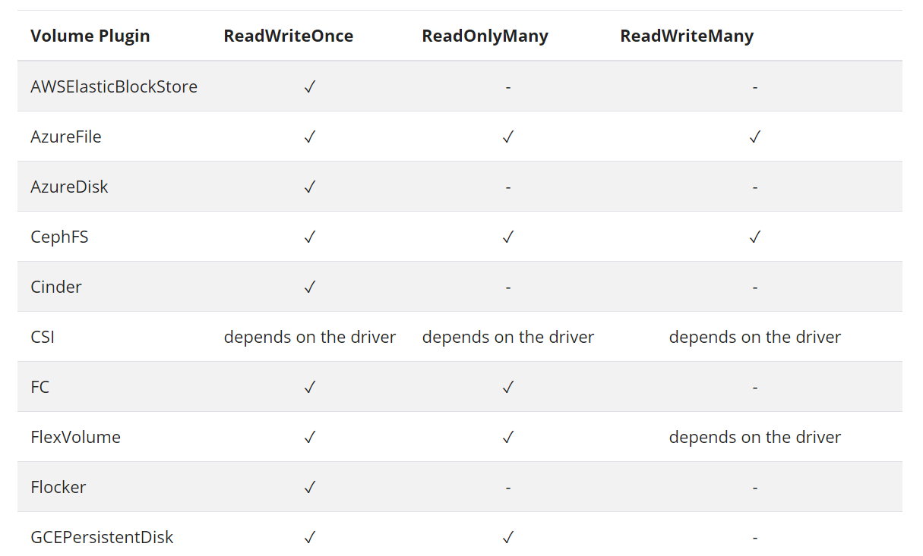
Access Types and Methods
Notes:
Before we look at how we upgrade our application, let’s try to understand Rollouts and Versioning in a deployment. Whenever you create a new deployment or upgrade the images in an existing deployment it triggers a Rollout. A rollout is the process of gradually deploying or upgrading your application containers. When you first create a deployment, it triggers a rollout. <click> A new rollout creates a new Deployment revision. Let’s call it revision 1. In the future when the application is upgraded <click> – meaning when the container version is updated to a new one – a new rollout is triggered and a new deployment revision is created named Revision 2. This helps us keep track of the changes made to our deployment and enables us to rollback to a previous version of deployment if necessary.

Slide 130
Persistent Volume
apiVersion: v1
kind: PersistentVolume
metadata:
name: task-pv-volume
labels:
type: local
spec:
storageClassName: manual
capacity:
storage: 10Gi
accessModes:
- ReadWriteOnce
hostPath:
path: "/mnt/data"
Notes:
Before we look at how we upgrade our application, let’s try to understand Rollouts and Versioning in a deployment. Whenever you create a new deployment or upgrade the images in an existing deployment it triggers a Rollout. A rollout is the process of gradually deploying or upgrading your application containers. When you first create a deployment, it triggers a rollout. <click> A new rollout creates a new Deployment revision. Let’s call it revision 1. In the future when the application is upgraded <click> – meaning when the container version is updated to a new one – a new rollout is triggered and a new deployment revision is created named Revision 2. This helps us keep track of the changes made to our deployment and enables us to rollback to a previous version of deployment if necessary.

Slide 131
Persistent Volume Claim
apiVersion: v1
kind: PersistentVolumeClaim
metadata:
name: task-pv-claim
spec:
storageClassName: manual
accessModes:
- ReadWriteOnce
resources:
requests:
storage: 3Gi
Notes:
Before we look at how we upgrade our application, let’s try to understand Rollouts and Versioning in a deployment. Whenever you create a new deployment or upgrade the images in an existing deployment it triggers a Rollout. A rollout is the process of gradually deploying or upgrading your application containers. When you first create a deployment, it triggers a rollout. <click> A new rollout creates a new Deployment revision. Let’s call it revision 1. In the future when the application is upgraded <click> – meaning when the container version is updated to a new one – a new rollout is triggered and a new deployment revision is created named Revision 2. This helps us keep track of the changes made to our deployment and enables us to rollback to a previous version of deployment if necessary.

Slide 132
DashBoards
Gagandeep
Notes:
Hello and welcome to this lecture on Kubernetes PODs. My name is Gagandeep Singh and we are learning Kubernetes for Beginners. In this lecture we will discuss about Kubernetes PODs.

Slide 133
DashBoards
K8’s comes with a WebUI you can use instead of the kubectl commands.
You will get an overview of running applications on your cluster.
Creating and Modifying individual kubernetes resources and workloads can also be done like KUBECTL create and delete command.
In general you can access the kubernetes webUI at https://<MASTER>/ui
Note: Now the process has been secured and changed since 1.8+ version
Gagandeep
Notes:
Before we head into understanding PODs, we would like to assume that the following have been setup already. At this point, we assume that the application is already developed and built into Docker Images and it is availalble on a Docker repository like Docker hub, so kubernetes can pull it down. We also assume that the Kubernetes cluster has already been setup and is working. This could be a single-node setup or a multi-node setup, doesn’t matter. All the services need to be in a running state.

Slide 134
DashBoards
https://github.com/kubernetes/dashboard
cd dashboard-master/ src/deploy/recommended/ kubernetes-dashboard.yaml
Expose the NodePort for AWS/Public IP’s, and your service should look like:
spec:
type: NodePort
ports:
- port: 443
targetPort: 8443
selector:
k8s-app: kubernetes-dashboard
Gagandeep
Notes:
Before we head into understanding PODs, we would like to assume that the following have been setup already. At this point, we assume that the application is already developed and built into Docker Images and it is availalble on a Docker repository like Docker hub, so kubernetes can pull it down. We also assume that the Kubernetes cluster has already been setup and is working. This could be a single-node setup or a multi-node setup, doesn’t matter. All the services need to be in a running state.

Slide 135
DashBoards
kubectl create -f kubernetes-dashboard.yaml
kubectl get pods -n namespace
kubectl get pods -n kube-system
kubectl get service -n kube-system
Excess the dashboard using WEB with mentioned port
Now use the below link to create a user and view the dashboard:
https://github.com/kubernetes/dashboard/wiki/Creating-sample-user
Gagandeep
Notes:
Before we head into understanding PODs, we would like to assume that the following have been setup already. At this point, we assume that the application is already developed and built into Docker Images and it is availalble on a Docker repository like Docker hub, so kubernetes can pull it down. We also assume that the Kubernetes cluster has already been setup and is working. This could be a single-node setup or a multi-node setup, doesn’t matter. All the services need to be in a running state.

Slide 136
DashBoards
https://github.com/kubernetes/dashboard/wiki/Creating-sample-user
apiVersion: v1
kind: ServiceAccount
metadata:
name: admin-user
namespace: kube-system
apiVersion: rbac.authorization.k8s.io/v1beta1
kind: ClusterRoleBinding
metadata:
name: admin-user
roleRef:
apiGroup: rbac.authorization.k8s.io
kind: ClusterRole
name: cluster-admin
subjects:
- kind: ServiceAccount
name: admin-user
namespace: kube-system
$ kubectl create –f <yaml.file>
$ kubectl -n kube-system describe secret $(kubectl -n kube-system get secret | grep admin-user | awk '{print $1}')
$ kubectl get services –n kube-system
Gagandeep
Notes:
Before we head into understanding PODs, we would like to assume that the following have been setup already. At this point, we assume that the application is already developed and built into Docker Images and it is availalble on a Docker repository like Docker hub, so kubernetes can pull it down. We also assume that the Kubernetes cluster has already been setup and is working. This could be a single-node setup or a multi-node setup, doesn’t matter. All the services need to be in a running state.

Slide 137
Service Accounts can be managed with CLI
kubectl get serviceaccounts --all-namespaces
kubectl get roles --all-namespaces
kubectl get rolebinding
kubectl create serviceaccount gagan
kubectl create role pod-reader --verb=get --verb=list --verb=watch --resource=pods
kubectl create rolebinding gagan --clusterrole=pod-reader --user=gagan
Gagandeep
Notes:
Before we head into understanding PODs, we would like to assume that the following have been setup already. At this point, we assume that the application is already developed and built into Docker Images and it is availalble on a Docker repository like Docker hub, so kubernetes can pull it down. We also assume that the Kubernetes cluster has already been setup and is working. This could be a single-node setup or a multi-node setup, doesn’t matter. All the services need to be in a running state.

Slide 138
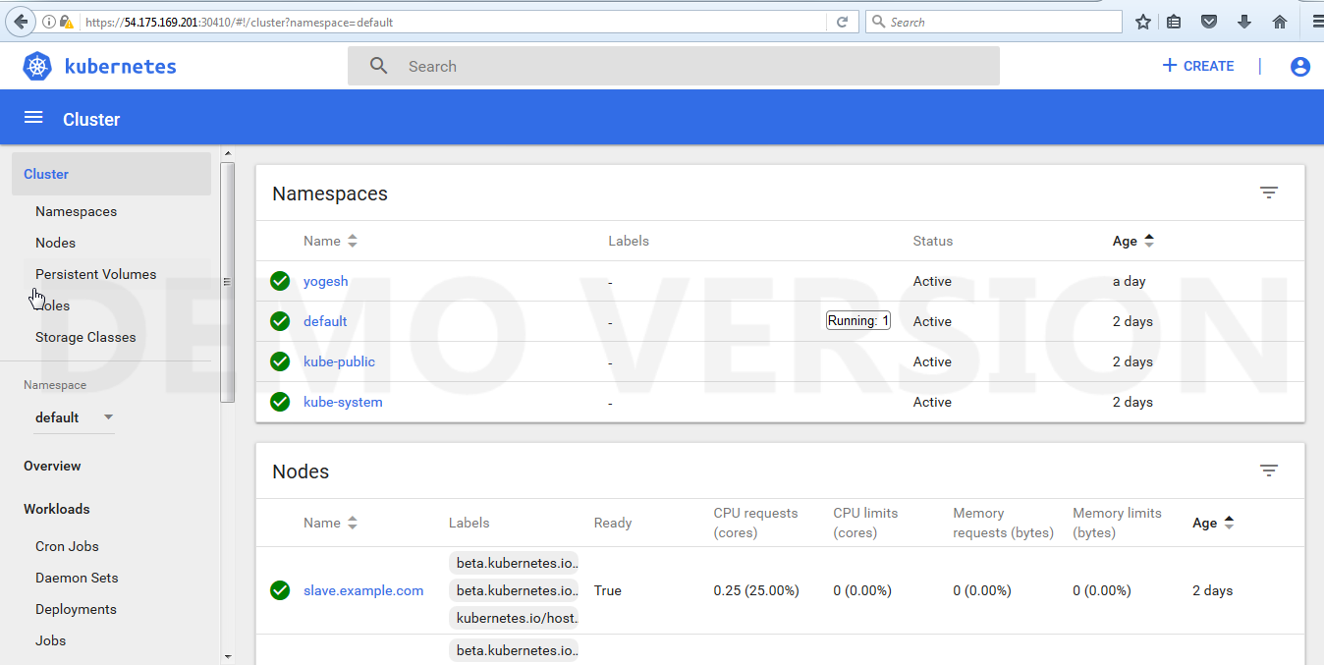
DashBoards
Notes:
Before we head into understanding PODs, we would like to assume that the following have been setup already. At this point, we assume that the application is already developed and built into Docker Images and it is availalble on a Docker repository like Docker hub, so kubernetes can pull it down. We also assume that the Kubernetes cluster has already been setup and is working. This could be a single-node setup or a multi-node setup, doesn’t matter. All the services need to be in a running state.

Slide 139
Addition/Deletion of a node to the Cluster
Gagandeep
Notes:
Hello and welcome to this lecture on Kubernetes PODs. My name is Gagandeep Singh and we are learning Kubernetes for Beginners. In this lecture we will discuss about Kubernetes PODs.

Slide 140
Node Taint & Toleration
Node affinity is a property of Pods that attracts them to a set of nodes (either as a preference or a hard requirement).
Taints are the opposite -- they allow a node to repel a set of pods.
Tolerations are applied to pods, and allow (but do not require) the pods to schedule onto nodes with matching taints.
https://kubernetes.io/docs/concepts/scheduling-eviction/taint-and-toleration/
Notes:
Before we head into understanding PODs, we would like to assume that the following have been setup already. At this point, we assume that the application is already developed and built into Docker Images and it is availalble on a Docker repository like Docker hub, so kubernetes can pull it down. We also assume that the Kubernetes cluster has already been setup and is working. This could be a single-node setup or a multi-node setup, doesn’t matter. All the services need to be in a running state.

Slide 141
Node cordon and draining
kubectl cordon my-node # Mark my-node as unschedulable
kubectl drain my-node # Drain my-node in preparation for maintenance
kubectl uncordon my-node # Mark my-node as schedulable
Notes:
Before we head into understanding PODs, we would like to assume that the following have been setup already. At this point, we assume that the application is already developed and built into Docker Images and it is availalble on a Docker repository like Docker hub, so kubernetes can pull it down. We also assume that the Kubernetes cluster has already been setup and is working. This could be a single-node setup or a multi-node setup, doesn’t matter. All the services need to be in a running state.

Slide 142
Remove node
To remove a Kubernetes worker node from the cluster, perform the following operations.
Migrate pods from the node
$ kubectl drain <node-name> --delete-local-data --ignore-daemonsets
Prevent a node from scheduling new pods use – Mark node as unschedulable
$ kubectl cordon <node-name>
Revert changes made to the node by ‘kubeadm join‘ – Run on worker node to be removed
$ sudo kubeadm reset # run it from worker node
Remove the node from cluster
$ kubectl delete node <node-name>
Notes:
Before we head into understanding PODs, we would like to assume that the following have been setup already. At this point, we assume that the application is already developed and built into Docker Images and it is availalble on a Docker repository like Docker hub, so kubernetes can pull it down. We also assume that the Kubernetes cluster has already been setup and is working. This could be a single-node setup or a multi-node setup, doesn’t matter. All the services need to be in a running state.

Slide 143
Node Addition
Create a New instance and perform all of the pre-requisties.
Check the token is valid or not by running "kubeadm token list"
Now generate the token using "kubeadm token create --print-join-command"
Run "kubeadm reset" on node if you ran the old join command
Finally run the newly generated token command
Go to master and run "kubectl get nodes"
Notes:
Before we head into understanding PODs, we would like to assume that the following have been setup already. At this point, we assume that the application is already developed and built into Docker Images and it is availalble on a Docker repository like Docker hub, so kubernetes can pull it down. We also assume that the Kubernetes cluster has already been setup and is working. This could be a single-node setup or a multi-node setup, doesn’t matter. All the services need to be in a running state.

Slide 144
NodeSelectors
Gagandeep
Notes:
Hello and welcome to this lecture on Kubernetes PODs. My name is Gagandeep Singh and we are learning Kubernetes for Beginners. In this lecture we will discuss about Kubernetes PODs.

Slide 145
Node Selector
You can also use labels to tag your nodes
Once nodes are tagged, you can use label selectors to let pods only run specific nodes
there are two steps required to run a pod on a specific set of nodes
- first you tag the node
- then you add a nodeSelector to your pod configuration
Notes:
Before we head into understanding PODs, we would like to assume that the following have been setup already. At this point, we assume that the application is already developed and built into Docker Images and it is availalble on a Docker repository like Docker hub, so kubernetes can pull it down. We also assume that the Kubernetes cluster has already been setup and is working. This could be a single-node setup or a multi-node setup, doesn’t matter. All the services need to be in a running state.

Slide 146
Node Selector
kubectl get nodes
kubectl get nodes --show-labels
kubectl create -f <yamlfile>
Run the shown yaml file and check the pod status you will find the error stating "node(s) didn't match node selector."
kubectl get pods
kubectl describe pod <pod-name>
kubectl label nodes <nodename> hardware=high-spec
kubectl label nodes <nodename> hardware=low-spec
As soon as you label the node you will get the POD in running condition (auto-healing)
CASE2: Change the nodeSelector to other node and re-run
apiVersion: v1
kind: Pod
metadata:
name: myapp-pod
labels:
app: myapp
type: front-end
spec:
containers:
- name: httpd-container
image: httpd
nodeSelector:
hardware: high-spec
Notes:
Before we head into understanding PODs, we would like to assume that the following have been setup already. At this point, we assume that the application is already developed and built into Docker Images and it is availalble on a Docker repository like Docker hub, so kubernetes can pull it down. We also assume that the Kubernetes cluster has already been setup and is working. This could be a single-node setup or a multi-node setup, doesn’t matter. All the services need to be in a running state.

Slide 147
Setting Role Labels
Adding a Role to a Worker Node:
[root@master ~]# kubectl label node worker1 node-role.kubernetes.io/linux-worker=worker1
node/worker1 labeled
[root@master ~]# kubectl get nodes
NAME STATUS ROLES AGE VERSION
master Ready master 12d v1.19.2
worker1 Ready linux-worker 12d v1.19.2
Removing a Role Label
[root@master ~]# kubectl label node worker1 node-role.kubernetes.io/linux-worker-
node/worker1 labeled
[root@master ~]# kubectl get nodes
NAME STATUS ROLES AGE VERSION
master Ready master 12d v1.19.2
worker1 Ready <none> 12d v1.19.2
[root@master ~]#
Notes:
Before we head into understanding PODs, we would like to assume that the following have been setup already. At this point, we assume that the application is already developed and built into Docker Images and it is availalble on a Docker repository like Docker hub, so kubernetes can pull it down. We also assume that the Kubernetes cluster has already been setup and is working. This could be a single-node setup or a multi-node setup, doesn’t matter. All the services need to be in a running state.

Slide 148
Kubernetes as a Service (PaaS Platform)
Gagandeep
Notes:
Hello and welcome to this lecture on Kubernetes PODs. My name is Mumshad Mannambeth and we are learning Kubernetes for Beginners. In this lecture we will discuss about Kubernetes PODs.

Slide 149
Kubernetes as a Service
Many Cloud Service providers provides Kubernetes as a Service.
They manages Kubernetes master service (Somewhere charged, somewhere no charges)
Worker nodes are charged and assigned to us.
We can deploy pods via GUI as well as command line.
Examples – EKS, GKE, AKS
Gagandeep
Notes:
Before we head into understanding PODs, we would like to assume that the following have been setup already. At this point, we assume that the application is already developed and built into Docker Images and it is availalble on a Docker repository like Docker hub, so kubernetes can pull it down. We also assume that the Kubernetes cluster has already been setup and is working. This could be a single-node setup or a multi-node setup, doesn’t matter. All the services need to be in a running state.

Slide 150
Autoscaling
Gagandeep
Notes:
Hello and welcome to this lecture. In this lecture we will try and understand Microservices architecture using a simple web application. We will then try and deploy this web application on multiple different kubernetes platforms.

Slide 151
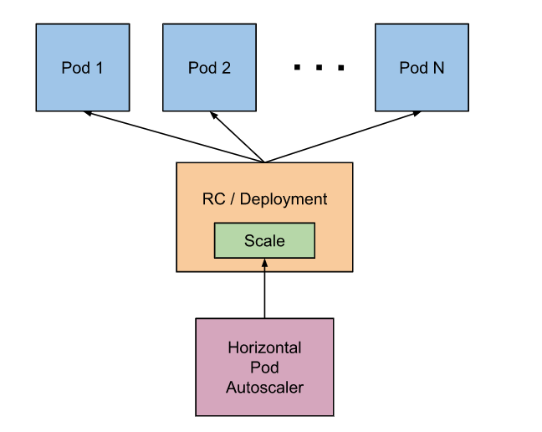
Autoscaling
Notes:
So let’s take the example voting app and try and deploy it on Kubernetes cluster. For this exercise we assume that the Kubernetes cluster is already setup and running. So what is our Goal? <click> <click> We need to deploy 5 different Docker containers with different application images such as redis and postgres for database and voting, result and worker for our application. So that’s our first step. <click> We then need to establish communication between the containers, so they have database connectivity and finally <click> publish ports on the voting and result app so we can access them from a web browser.
Let’s start with the first step of deploying containers. But we learned that in Kubernetes we cannot deploy containers directly. We must create PODs. <click> So the first step is then to create PODs for each component. Once we create the PODs, we need to enable connectivity between the PODs, such as enabling the voting app to reach the redis container and enabling web-app to reach the redis and postgres containers. <click> This is done by creating services. <click> And finally we enable external access and this is again done by creating a different type of service known as LoadBalancer. These steps should help us setup the voting-application on Kubernetes cluster. In the upcoming demo we will see how to accomplish these tasks and run docker containers on Kubernetes.

Slide 152
Autoscaling
kubectl autoscale deployment myapp-deployment --cpu-percent=50 --min=1 --max=10
kubectl get hpa
#but you need to set a metric deployment first otherwise it'wont be able to collect the metric
kubectl delete hpa myapp-deployment
https://kubernetes.io/docs/tasks/run-application/horizontal-pod-autoscale-walkthrough/
Notes:
So let’s take the example voting app and try and deploy it on Kubernetes cluster. For this exercise we assume that the Kubernetes cluster is already setup and running. So what is our Goal? <click> <click> We need to deploy 5 different Docker containers with different application images such as redis and postgres for database and voting, result and worker for our application. So that’s our first step. <click> We then need to establish communication between the containers, so they have database connectivity and finally <click> publish ports on the voting and result app so we can access them from a web browser.
Let’s start with the first step of deploying containers. But we learned that in Kubernetes we cannot deploy containers directly. We must create PODs. <click> So the first step is then to create PODs for each component. Once we create the PODs, we need to enable connectivity between the PODs, such as enabling the voting app to reach the redis container and enabling web-app to reach the redis and postgres containers. <click> This is done by creating services. <click> And finally we enable external access and this is again done by creating a different type of service known as LoadBalancer. These steps should help us setup the voting-application on Kubernetes cluster. In the upcoming demo we will see how to accomplish these tasks and run docker containers on Kubernetes.

Slide 153
Helm Charts
Gagandeep
Notes:
Hello and welcome to this lecture. In this lecture we will try and understand Microservices architecture using a simple web application. We will then try and deploy this web application on multiple different kubernetes platforms.

Slide 154
Helm
Kubernetes Package Manager
In June 2018, Helm was adopted as an official CNCF project.
A Helm chart is simply a collection of YAML template files organized into a specific directory structure.
It play a large role in optimizing an organization’s CI/CD integration with Kubernetes.
Manage multiple environments together
With you you’ll have ability to provide application configuration during deployment. Not only you can specify the Kubernetes resources (deployments, services, etc.) that make up your application, but also environment-specific configuration for those resources.
Notes:
So let’s take the example voting app and try and deploy it on Kubernetes cluster. For this exercise we assume that the Kubernetes cluster is already setup and running. So what is our Goal? <click> <click> We need to deploy 5 different Docker containers with different application images such as redis and postgres for database and voting, result and worker for our application. So that’s our first step. <click> We then need to establish communication between the containers, so they have database connectivity and finally <click> publish ports on the voting and result app so we can access them from a web browser.
Let’s start with the first step of deploying containers. But we learned that in Kubernetes we cannot deploy containers directly. We must create PODs. <click> So the first step is then to create PODs for each component. Once we create the PODs, we need to enable connectivity between the PODs, such as enabling the voting app to reach the redis container and enabling web-app to reach the redis and postgres containers. <click> This is done by creating services. <click> And finally we enable external access and this is again done by creating a different type of service known as LoadBalancer. These steps should help us setup the voting-application on Kubernetes cluster. In the upcoming demo we will see how to accomplish these tasks and run docker containers on Kubernetes.

Slide 155
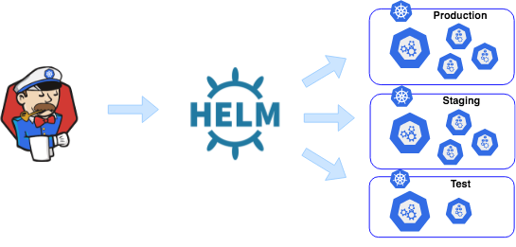
Helm Charts
Notes:
So let’s take the example voting app and try and deploy it on Kubernetes cluster. For this exercise we assume that the Kubernetes cluster is already setup and running. So what is our Goal? <click> <click> We need to deploy 5 different Docker containers with different application images such as redis and postgres for database and voting, result and worker for our application. So that’s our first step. <click> We then need to establish communication between the containers, so they have database connectivity and finally <click> publish ports on the voting and result app so we can access them from a web browser.
Let’s start with the first step of deploying containers. But we learned that in Kubernetes we cannot deploy containers directly. We must create PODs. <click> So the first step is then to create PODs for each component. Once we create the PODs, we need to enable connectivity between the PODs, such as enabling the voting app to reach the redis container and enabling web-app to reach the redis and postgres containers. <click> This is done by creating services. <click> And finally we enable external access and this is again done by creating a different type of service known as LoadBalancer. These steps should help us setup the voting-application on Kubernetes cluster. In the upcoming demo we will see how to accomplish these tasks and run docker containers on Kubernetes.

Slide 156
Working with Helm
Do the Installation by running below or reach out to https://helm.sh/docs/intro/install:
https://raw.githubusercontent.com/helm/helm/master/scripts/get-helm-3 | bash
Create chart with:
helm create [chartname]
Modify the values.yaml and put entries as per your requirement
helm package [chartname] // to create package
helm install [chartname] // to Install a chart
Helm ls // to list charts
Helm upgrade [generated-dep-name] chart-name // to upgrade
Helm rollback [generated-dep-name] version // to rollback
Helm delete [generated-dep-name] // to delete the deployed packages
Notes:
So let’s take the example voting app and try and deploy it on Kubernetes cluster. For this exercise we assume that the Kubernetes cluster is already setup and running. So what is our Goal? <click> <click> We need to deploy 5 different Docker containers with different application images such as redis and postgres for database and voting, result and worker for our application. So that’s our first step. <click> We then need to establish communication between the containers, so they have database connectivity and finally <click> publish ports on the voting and result app so we can access them from a web browser.
Let’s start with the first step of deploying containers. But we learned that in Kubernetes we cannot deploy containers directly. We must create PODs. <click> So the first step is then to create PODs for each component. Once we create the PODs, we need to enable connectivity between the PODs, such as enabling the voting app to reach the redis container and enabling web-app to reach the redis and postgres containers. <click> This is done by creating services. <click> And finally we enable external access and this is again done by creating a different type of service known as LoadBalancer. These steps should help us setup the voting-application on Kubernetes cluster. In the upcoming demo we will see how to accomplish these tasks and run docker containers on Kubernetes.

Slide 157
Service Mesh
Gagandeep
Notes:
Hello and welcome to this lecture. In this lecture we will try and understand Microservices architecture using a simple web application. We will then try and deploy this web application on multiple different kubernetes platforms.

Slide 158
Service Mesh
Service Mesh is a “dedicated infrastructure layer for making service-to-service communication safe, fast, and reliable”
Benefits:
• Service discovery: Registry and discovery of services
• Routing: Intelligent load balancing and network routing, better health checks, automatic deployment patterns such as blue-green or canary deployments
• Resilience: retries, timeouts and circuit breakers
• Security: TLS-based encryption including key management
• Telemetry: collection of metrics and tracing identifiers
Notes:
So let’s take the example voting app and try and deploy it on Kubernetes cluster. For this exercise we assume that the Kubernetes cluster is already setup and running. So what is our Goal? <click> <click> We need to deploy 5 different Docker containers with different application images such as redis and postgres for database and voting, result and worker for our application. So that’s our first step. <click> We then need to establish communication between the containers, so they have database connectivity and finally <click> publish ports on the voting and result app so we can access them from a web browser.
Let’s start with the first step of deploying containers. But we learned that in Kubernetes we cannot deploy containers directly. We must create PODs. <click> So the first step is then to create PODs for each component. Once we create the PODs, we need to enable connectivity between the PODs, such as enabling the voting app to reach the redis container and enabling web-app to reach the redis and postgres containers. <click> This is done by creating services. <click> And finally we enable external access and this is again done by creating a different type of service known as LoadBalancer. These steps should help us setup the voting-application on Kubernetes cluster. In the upcoming demo we will see how to accomplish these tasks and run docker containers on Kubernetes.

Slide 159
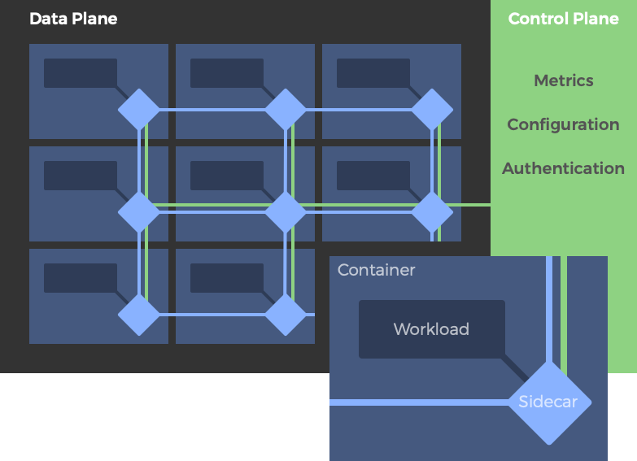
Service Mesh Architecture
Notes:
So let’s take the example voting app and try and deploy it on Kubernetes cluster. For this exercise we assume that the Kubernetes cluster is already setup and running. So what is our Goal? <click> <click> We need to deploy 5 different Docker containers with different application images such as redis and postgres for database and voting, result and worker for our application. So that’s our first step. <click> We then need to establish communication between the containers, so they have database connectivity and finally <click> publish ports on the voting and result app so we can access them from a web browser.
Let’s start with the first step of deploying containers. But we learned that in Kubernetes we cannot deploy containers directly. We must create PODs. <click> So the first step is then to create PODs for each component. Once we create the PODs, we need to enable connectivity between the PODs, such as enabling the voting app to reach the redis container and enabling web-app to reach the redis and postgres containers. <click> This is done by creating services. <click> And finally we enable external access and this is again done by creating a different type of service known as LoadBalancer. These steps should help us setup the voting-application on Kubernetes cluster. In the upcoming demo we will see how to accomplish these tasks and run docker containers on Kubernetes.

Slide 160
Service Mesh- Key Players
Envoy: an open-source proxy server developed at Lyft. Mainly Dataplane with convenient configuration API.
Linkerd: An open-source project sponsored by Buoyant and the original service mesh.
Istio: The most popular service mesh today. It was launched jointly by Google, IBM and Lyft and is expected to ultimately join the CNCF. Istio is a control plane that needs to be paired with a data plane to form a service mesh.
Consul: Sponsored by hashicorp. Specializes in service discovery. Consul works with several data planes and can be used with or without other control planes such as Istio.
Notes:
So let’s take the example voting app and try and deploy it on Kubernetes cluster. For this exercise we assume that the Kubernetes cluster is already setup and running. So what is our Goal? <click> <click> We need to deploy 5 different Docker containers with different application images such as redis and postgres for database and voting, result and worker for our application. So that’s our first step. <click> We then need to establish communication between the containers, so they have database connectivity and finally <click> publish ports on the voting and result app so we can access them from a web browser.
Let’s start with the first step of deploying containers. But we learned that in Kubernetes we cannot deploy containers directly. We must create PODs. <click> So the first step is then to create PODs for each component. Once we create the PODs, we need to enable connectivity between the PODs, such as enabling the voting app to reach the redis container and enabling web-app to reach the redis and postgres containers. <click> This is done by creating services. <click> And finally we enable external access and this is again done by creating a different type of service known as LoadBalancer. These steps should help us setup the voting-application on Kubernetes cluster. In the upcoming demo we will see how to accomplish these tasks and run docker containers on Kubernetes.

Slide 161
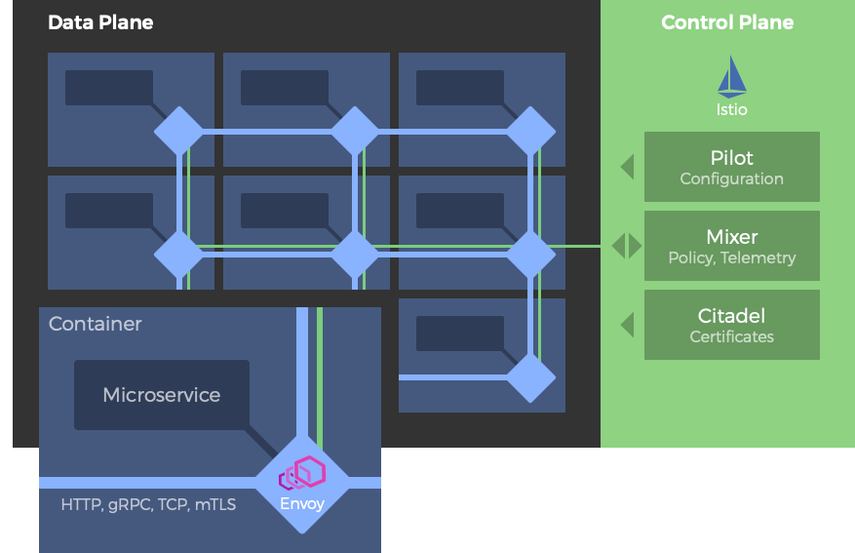
Service Mesh- ISTIO
Notes:
So let’s take the example voting app and try and deploy it on Kubernetes cluster. For this exercise we assume that the Kubernetes cluster is already setup and running. So what is our Goal? <click> <click> We need to deploy 5 different Docker containers with different application images such as redis and postgres for database and voting, result and worker for our application. So that’s our first step. <click> We then need to establish communication between the containers, so they have database connectivity and finally <click> publish ports on the voting and result app so we can access them from a web browser.
Let’s start with the first step of deploying containers. But we learned that in Kubernetes we cannot deploy containers directly. We must create PODs. <click> So the first step is then to create PODs for each component. Once we create the PODs, we need to enable connectivity between the PODs, such as enabling the voting app to reach the redis container and enabling web-app to reach the redis and postgres containers. <click> This is done by creating services. <click> And finally we enable external access and this is again done by creating a different type of service known as LoadBalancer. These steps should help us setup the voting-application on Kubernetes cluster. In the upcoming demo we will see how to accomplish these tasks and run docker containers on Kubernetes.

Slide 162
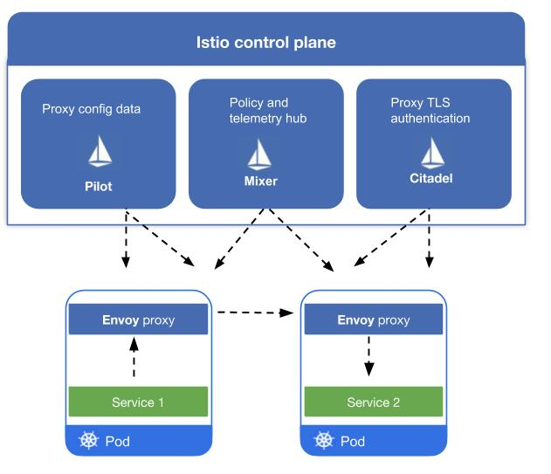
Service Mesh- ISTIO
Notes:
So let’s take the example voting app and try and deploy it on Kubernetes cluster. For this exercise we assume that the Kubernetes cluster is already setup and running. So what is our Goal? <click> <click> We need to deploy 5 different Docker containers with different application images such as redis and postgres for database and voting, result and worker for our application. So that’s our first step. <click> We then need to establish communication between the containers, so they have database connectivity and finally <click> publish ports on the voting and result app so we can access them from a web browser.
Let’s start with the first step of deploying containers. But we learned that in Kubernetes we cannot deploy containers directly. We must create PODs. <click> So the first step is then to create PODs for each component. Once we create the PODs, we need to enable connectivity between the PODs, such as enabling the voting app to reach the redis container and enabling web-app to reach the redis and postgres containers. <click> This is done by creating services. <click> And finally we enable external access and this is again done by creating a different type of service known as LoadBalancer. These steps should help us setup the voting-application on Kubernetes cluster. In the upcoming demo we will see how to accomplish these tasks and run docker containers on Kubernetes.

Slide 163
Service Mesh- ISTIO
Pilot: Connectivity and Communication
Traffic management
Fault injection
Layer 7 Load balancing
Mixer: Monitoring and Observability
Backend abstraction with policy control and telemetry collections
Latency
Reliability- Additional caching for Sidecars
Citadel(Galley): Encryption and Authentication
Service authentication Authentication policy
RBAC
TLS authentication & Key management
Notes:
So let’s take the example voting app and try and deploy it on Kubernetes cluster. For this exercise we assume that the Kubernetes cluster is already setup and running. So what is our Goal? <click> <click> We need to deploy 5 different Docker containers with different application images such as redis and postgres for database and voting, result and worker for our application. So that’s our first step. <click> We then need to establish communication between the containers, so they have database connectivity and finally <click> publish ports on the voting and result app so we can access them from a web browser.
Let’s start with the first step of deploying containers. But we learned that in Kubernetes we cannot deploy containers directly. We must create PODs. <click> So the first step is then to create PODs for each component. Once we create the PODs, we need to enable connectivity between the PODs, such as enabling the voting app to reach the redis container and enabling web-app to reach the redis and postgres containers. <click> This is done by creating services. <click> And finally we enable external access and this is again done by creating a different type of service known as LoadBalancer. These steps should help us setup the voting-application on Kubernetes cluster. In the upcoming demo we will see how to accomplish these tasks and run docker containers on Kubernetes.

Slide 164
Microservices
Gagandeep
Notes:
Hello and welcome to this lecture. In this lecture we will try and understand Microservices architecture using a simple web application. We will then try and deploy this web application on multiple different kubernetes platforms.

Slide 165
Kubernetes definition File
Version
v1
pod-definition.yml
apiVersion:
kind:
metadata:
spec:
v1
Kind
Pod
Deployment
Service
pod
Metadata
Name
Labels
name: my-nginx
Specification
containers
ports
containers:
- name: nginx
image: nginx
ports:
- containerPort: 80
kubectl create –f pod-definition.yml
Notes:
In Docker swarm we created stacks using YAML based docker-compose files. Similarly, in Kubernetes Pods, deployments and services are all created using a <click> YAML based definition file. The format of the file is a bit different than the docker-compose file. <click> There are 4 major sections in the file. <click> The version describes the version of schema we are using. The current version is 1, so you can set it to v1. <click> The kind describes the type of resource we are defining in the Yaml file – it could be Pod, deployment or service. So we could use YAML files to define all of the different resources we create in Kubernetes in place of a create command with a lot of different options passed in as arguments. <click> There are other types of resources as well but we will skip going into those for now. <click> The next is metadata and this is were we provide additional information about our configuration such as its names, custom labels and many other things. <click> And finally we have specification which is were we specify the actual deployment definition such as the type of containers that form the pod, the images used, the ports exposed etc.
We will now try to create a simple pod definition. <click> In the pod-definition.yml file update the apiVersion to v1. Because that’s the latest stable version. <click> The kind of deployment is pod, because we are creating a pod. <click> In metadata we will add a name and set it to my-nginx, so that will be the name of the pod. <click> Under specification, we will add containers and provide the containers we want to be part of this pod. In our case we are creating a one container per pod setup, so we will simply add a single container and use the nginx image. We will also add a ports section to expose port 80 on the nginx container so we can access it. <click> Once done, run the kubectl create command and provide the –f parameter to input the pod-definition.yml file. Kubernetes will then read the definition file and create the containers as required. Similarly we could create multiple different definition files one for each pod, deployment or service we need and execute the kubectl create command against those files to setup our application stack.

Slide 166

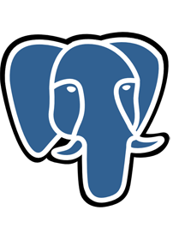
Example voting app
Service
Service
POD
POD
voting-app
result-app
Goals:
Deploy Containers
Enable Connectivity
External Access
Steps:
Deploy PODs
Create Services (ClusterIP)
Create Services (LoadBalancer)
POD
POD
Service
redis
db
Service
POD
worker
Notes:
So let’s take the example voting app and try and deploy it on Kubernetes cluster. For this exercise we assume that the Kubernetes cluster is already setup and running. So what is our Goal? <click> <click> We need to deploy 5 different Docker containers with different application images such as redis and postgres for database and voting, result and worker for our application. So that’s our first step. <click> We then need to establish communication between the containers, so they have database connectivity and finally <click> publish ports on the voting and result app so we can access them from a web browser.
Let’s start with the first step of deploying containers. But we learned that in Kubernetes we cannot deploy containers directly. We must create PODs. <click> So the first step is then to create PODs for each component. Once we create the PODs, we need to enable connectivity between the PODs, such as enabling the voting app to reach the redis container and enabling web-app to reach the redis and postgres containers. <click> This is done by creating services. <click> And finally we enable external access and this is again done by creating a different type of service known as LoadBalancer. These steps should help us setup the voting-application on Kubernetes cluster. In the upcoming demo we will see how to accomplish these tasks and run docker containers on Kubernetes.

Slide 167


Slide 168
Deployment
Updates and Rollback
Gagandeep
Notes:
In this lecture we will talk about updates and rollbacks in a Deployment.

Slide 169
ResourceUsageMonitoring
Gagandeep
Notes:
Hello and welcome to this lecture on Kubernetes PODs. My name is Gagandeep Singh and we are learning Kubernetes for Beginners. In this lecture we will discuss about Kubernetes PODs.

Slide 170
ResourceMonitoring
Heapster enables Container Cluster Monitoring and Performance Analysis
It provides a monitoring platform for Kubernetes
Heapster exports cluster metrics via REST endpoints
We will use Heapster, InfluxDB and Grafana Dashboards for Visualizations
All these 3 are started in PODS
https://github.com/kubernetes/heapster
We need to change some of the configurations, we will see in DEMO
Gagandeep
Notes:
Before we head into understanding PODs, we would like to assume that the following have been setup already. At this point, we assume that the application is already developed and built into Docker Images and it is availalble on a Docker repository like Docker hub, so kubernetes can pull it down. We also assume that the Kubernetes cluster has already been setup and is working. This could be a single-node setup or a multi-node setup, doesn’t matter. All the services need to be in a running state.

Slide 171
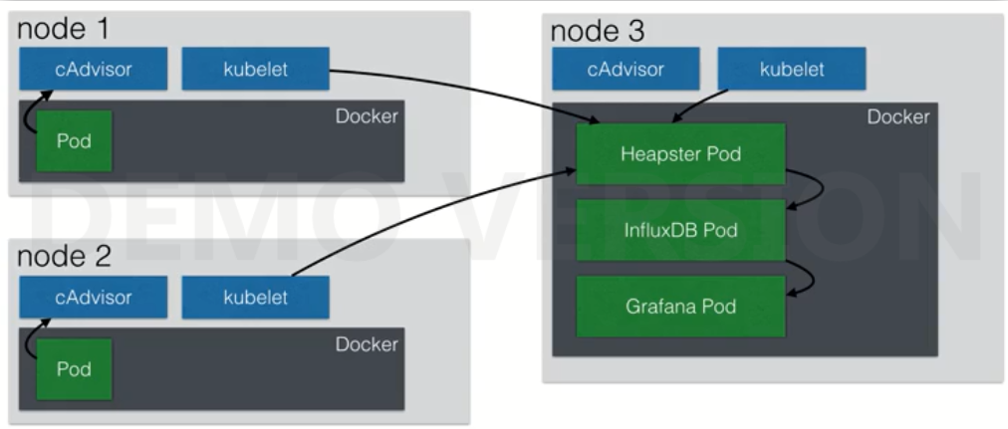
ResourceMonitoring
Notes:
Before we head into understanding PODs, we would like to assume that the following have been setup already. At this point, we assume that the application is already developed and built into Docker Images and it is availalble on a Docker repository like Docker hub, so kubernetes can pull it down. We also assume that the Kubernetes cluster has already been setup and is working. This could be a single-node setup or a multi-node setup, doesn’t matter. All the services need to be in a running state.

Slide 172
Stay connected
Gagandeep.singh@techlanders.com
contactus@techlanders.com
https://www.linkedin.com/in/gagandeep-gawri
+91 9654656667
Notes:
We are at the end of the Kubernetes for Beginners course. I hope I have covered enough topics to get you started with Kubernetes. We started with Containers and Docker and we looked what container orchestration is. We looked at various options available to setup kubernetes. We went through some of the concepts such as PODs, ReplicaSets, Deployments and Services. We also looked at Networking in Kubernetes. We also spent some time on working with kubectl commands and kubernetes definition files. I hope you got enough hands-on experience in developing kubernetes definition files. And finally we also saw how to deploy a sample microservices application on Kubernetes on Google Cloud Platform.
I will be adding additional topics to the course in the near future. So watch out for an announcement from me. In case you need me to cover any other topics, feel free to send me a message or post a question and I will try my best to add a new lecture on it.
We also have an assignment as part of this course. So if you have time, please go ahead and develop your solution and submit your assignment. Feel free to review other students assignments and share your views on them.
It was really nice having you for this course. I hope you gained enough knowledge and experience to get started with kubernetes at your work or otherwise and I wish you good luck in your Kubernetes Journey. See you in the next course, until then Good Bye!

